Slide 1
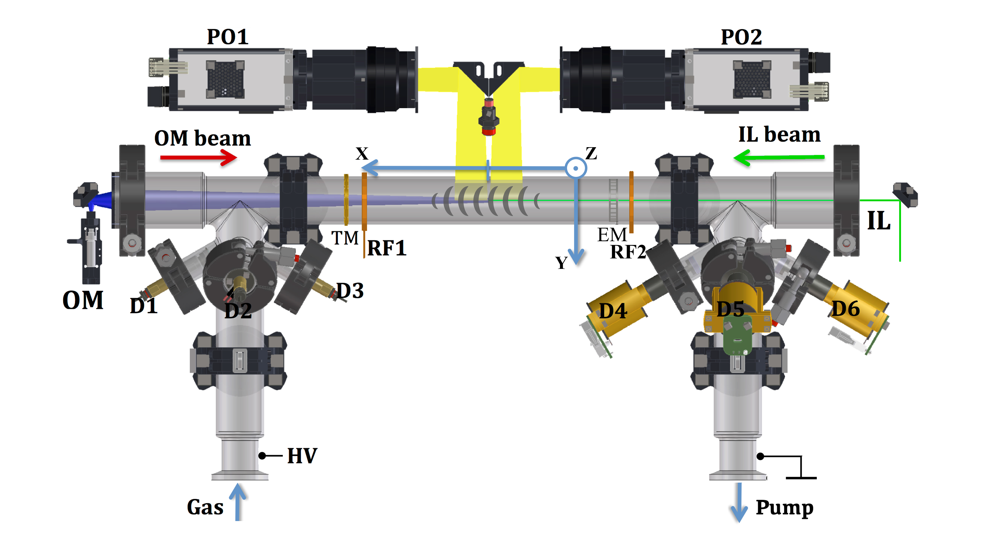
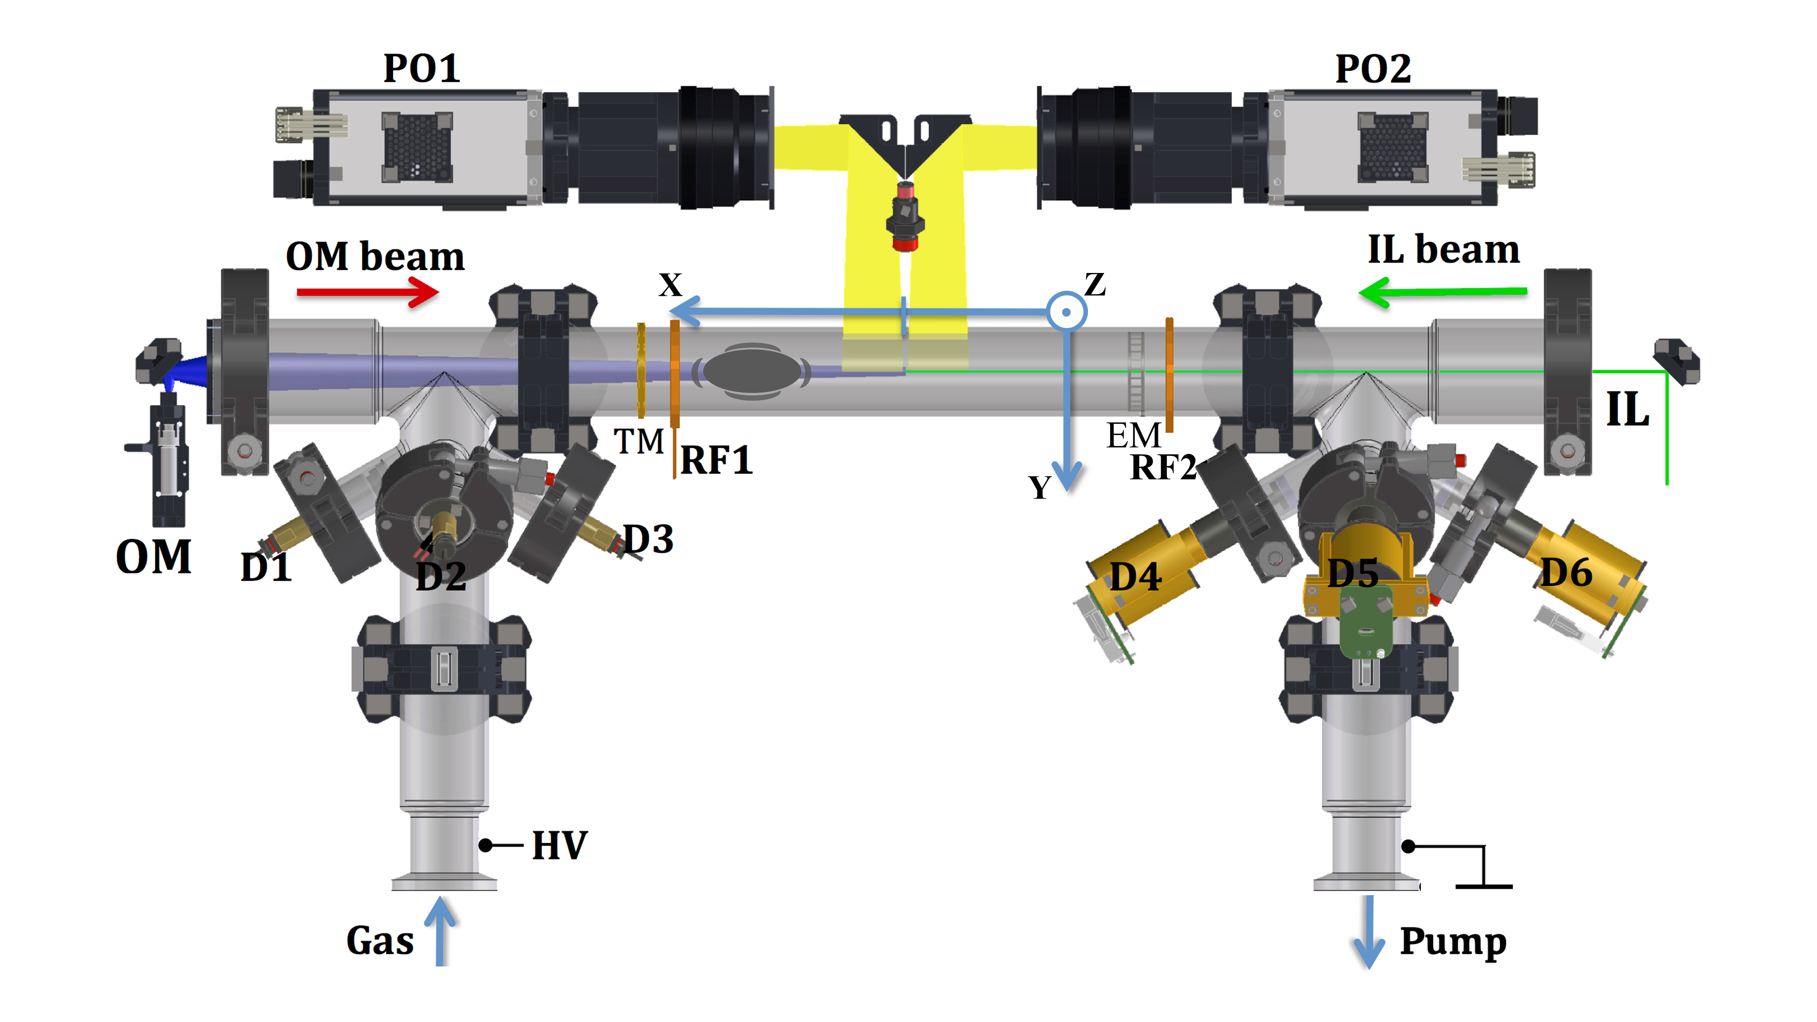

Introduction
1.
1b.
2.
2b.
Forward (F)
Backward (B)
I = - 0.5 mA
I = 0.5 mA

Slide 2
Introduction
V_group
Forward (F)
Backward (B)
I = - 0.5 mA
I = 0.5 mA

Slide 3
Introduction
C_daw = v_group – v_phase_measured
V_group
Forward (F)
Backward (B)
I = - 0.5 mA
I = 0.5 mA

Slide 4
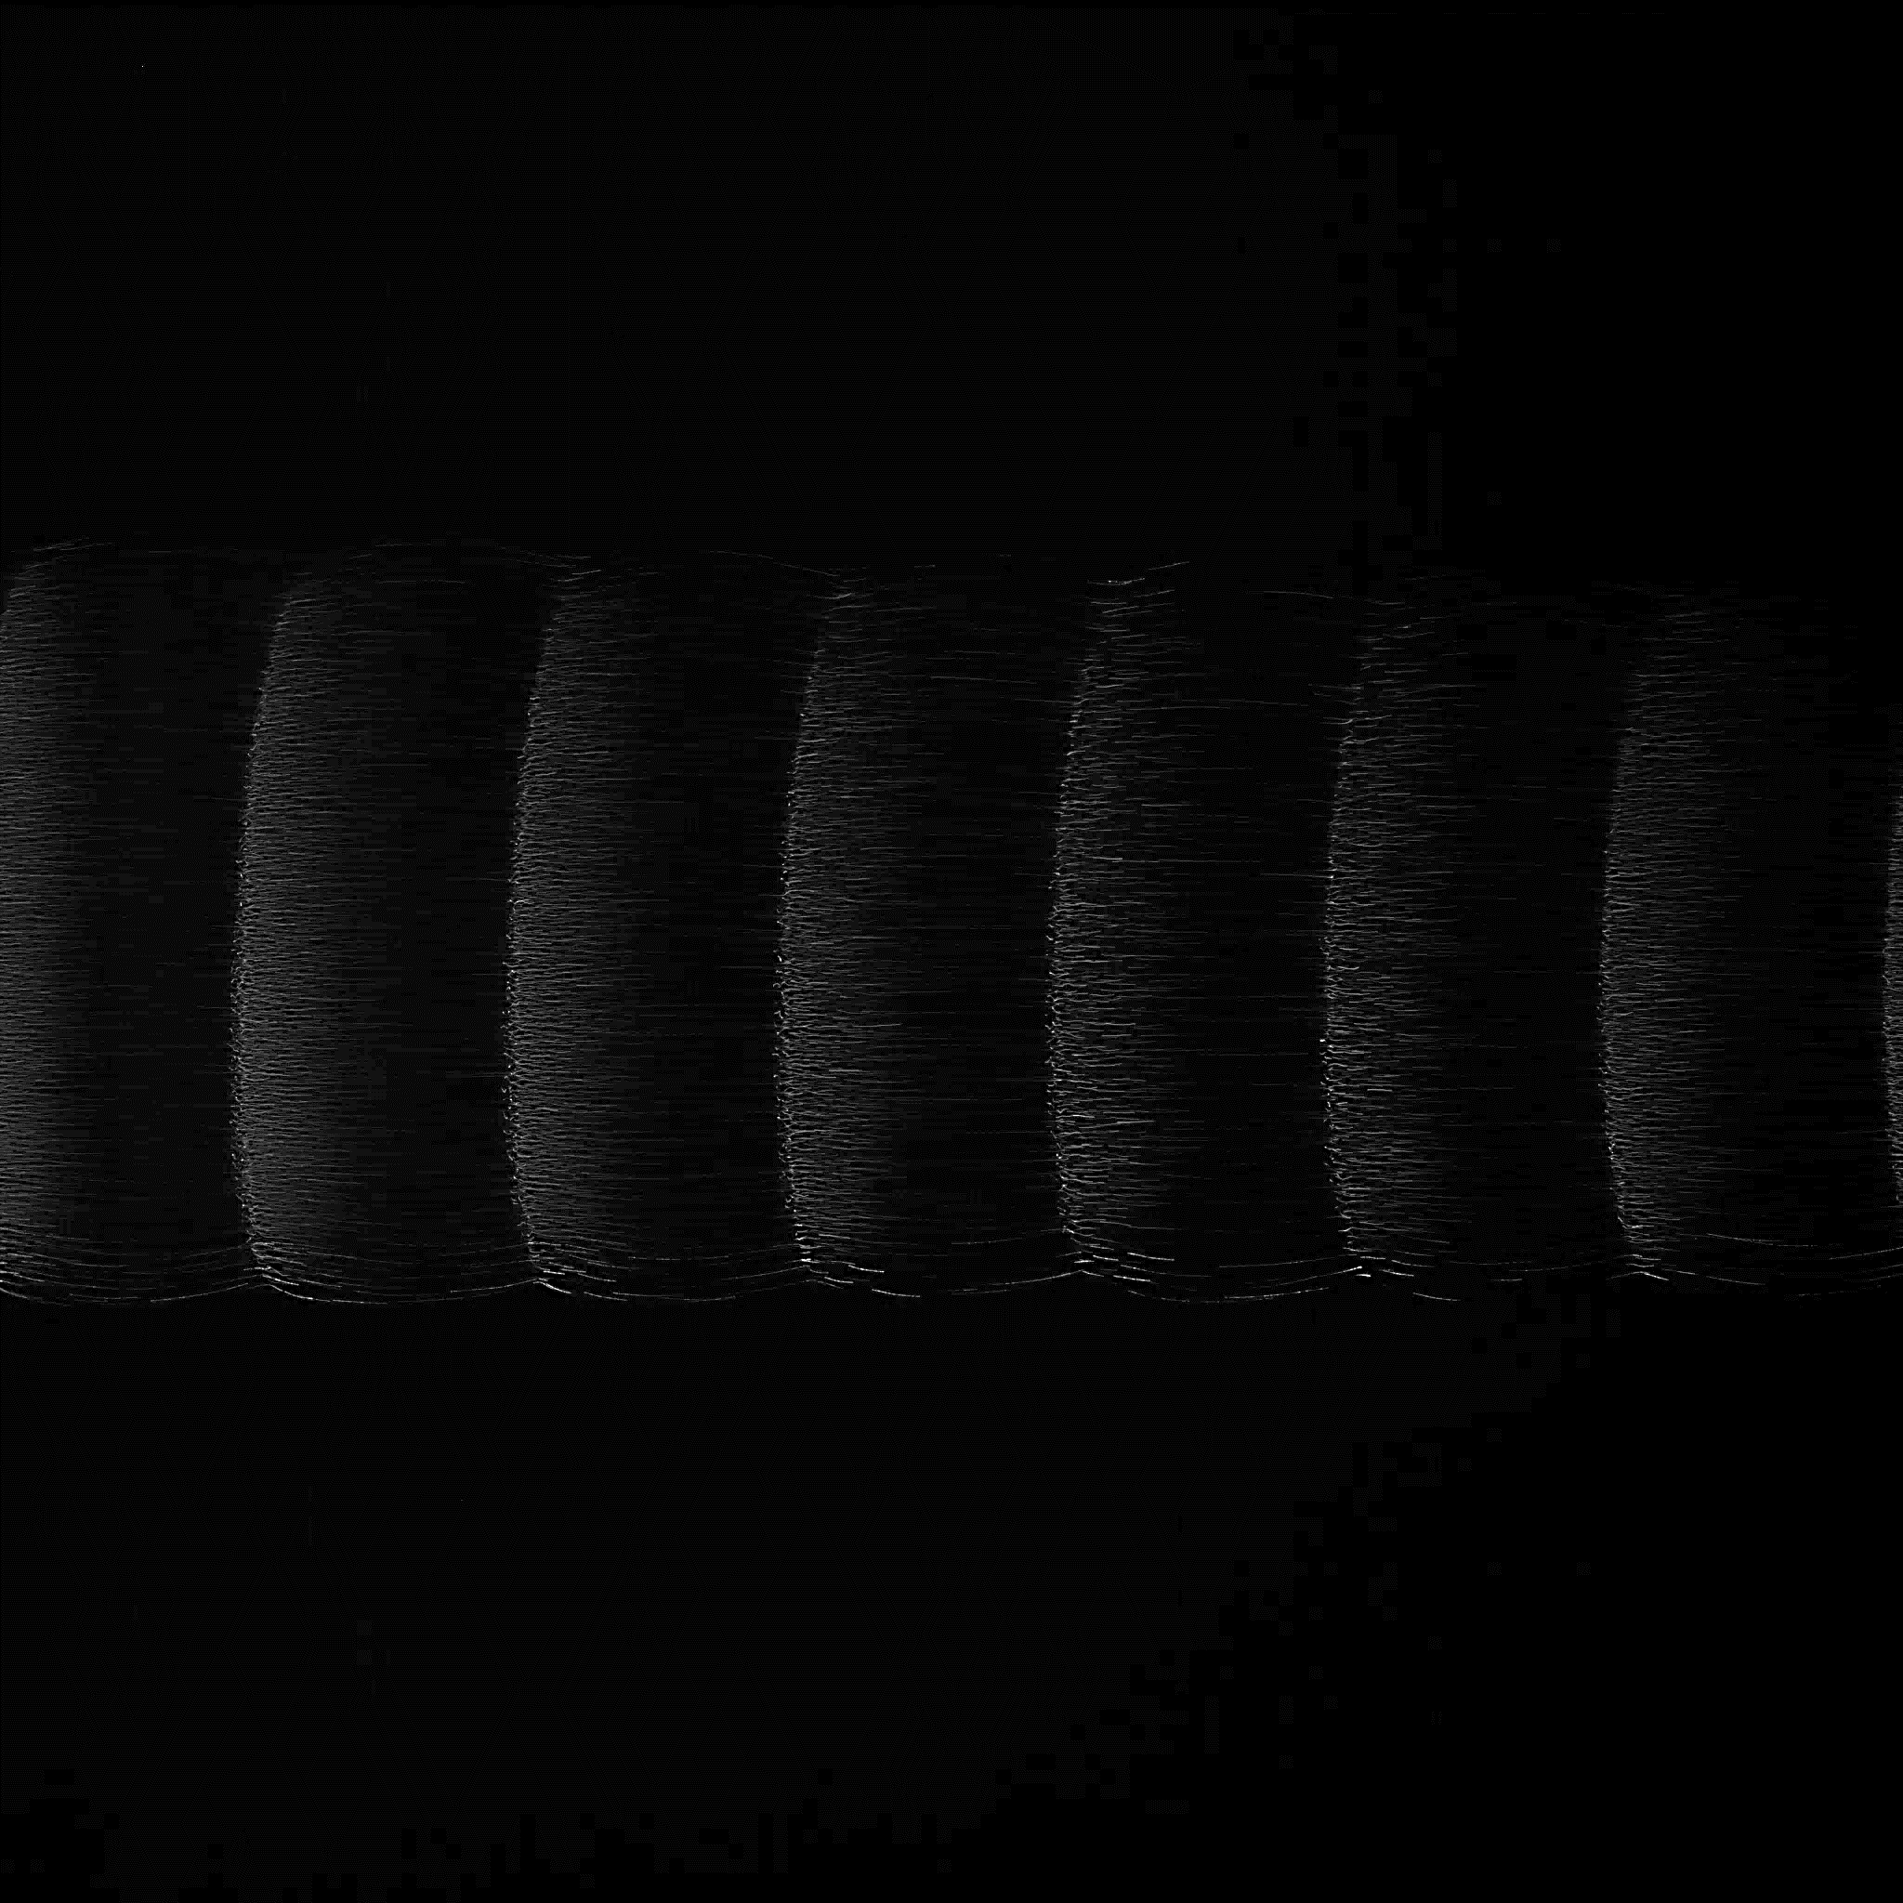
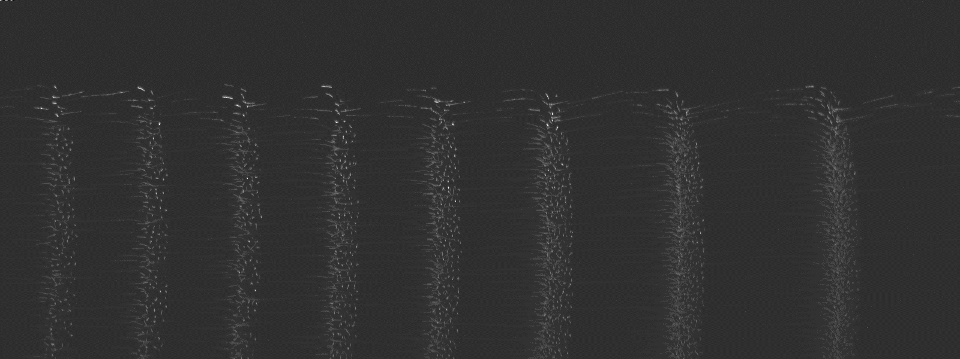
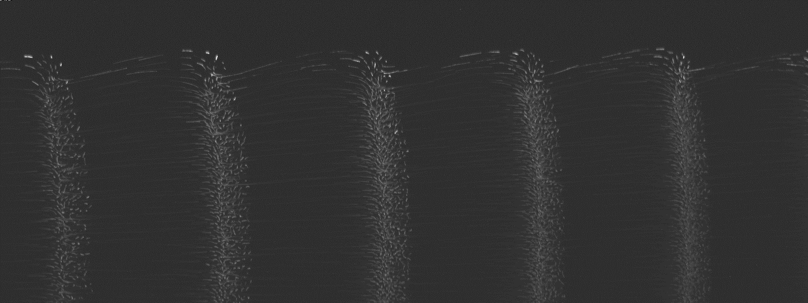
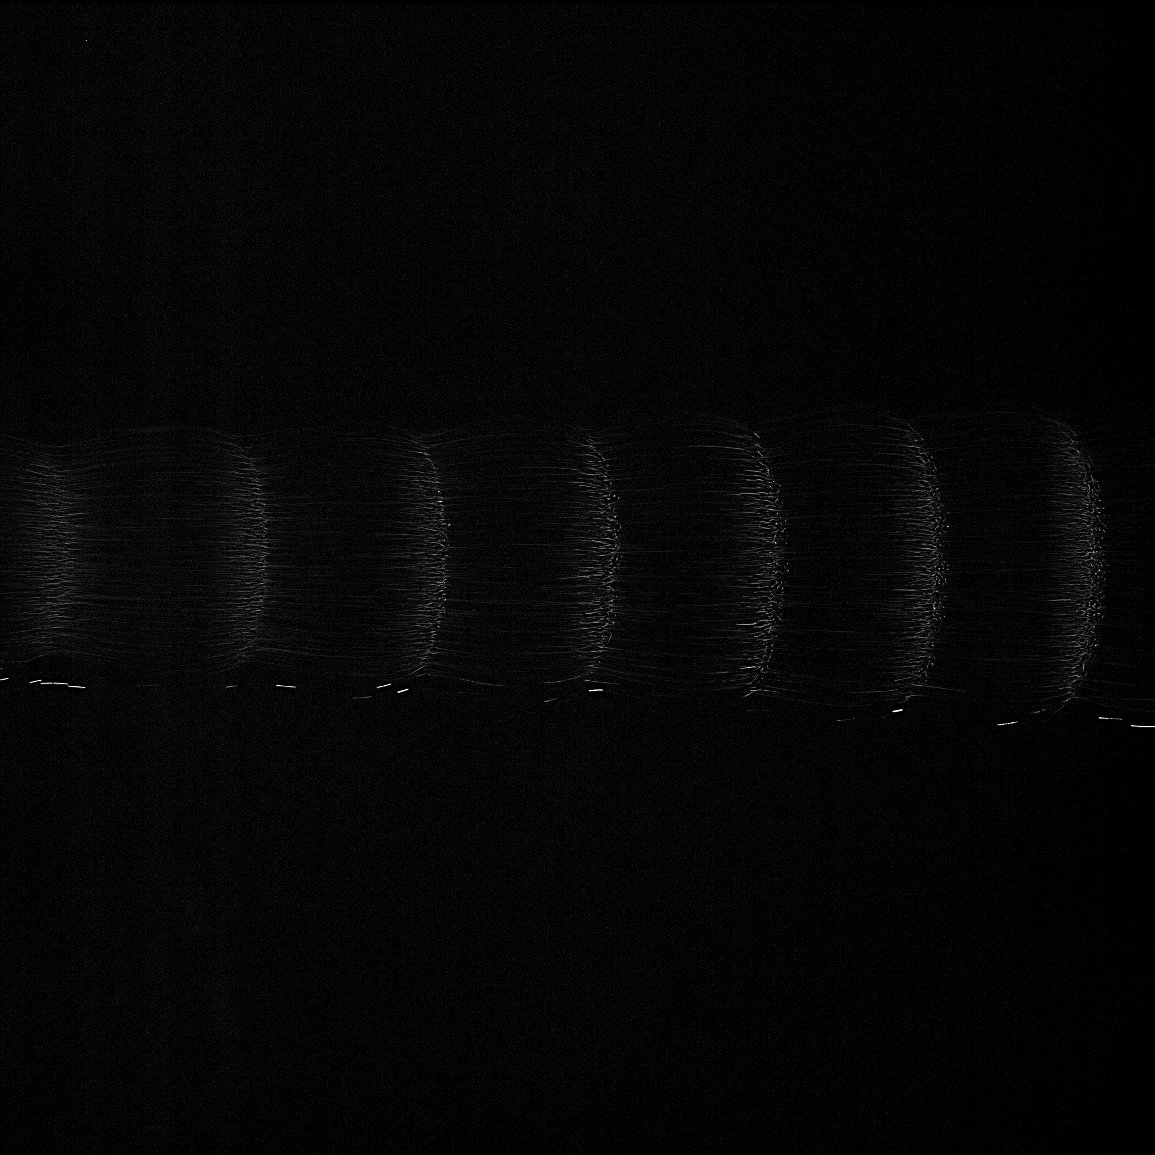
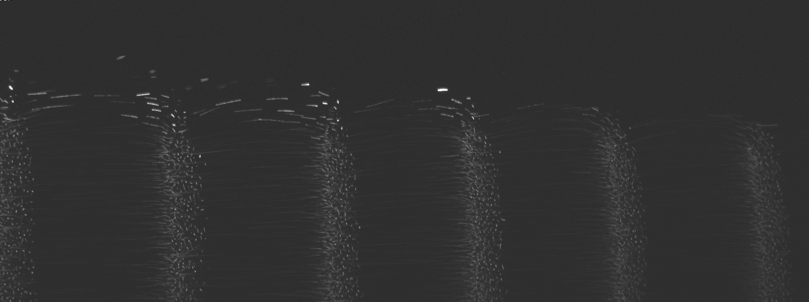

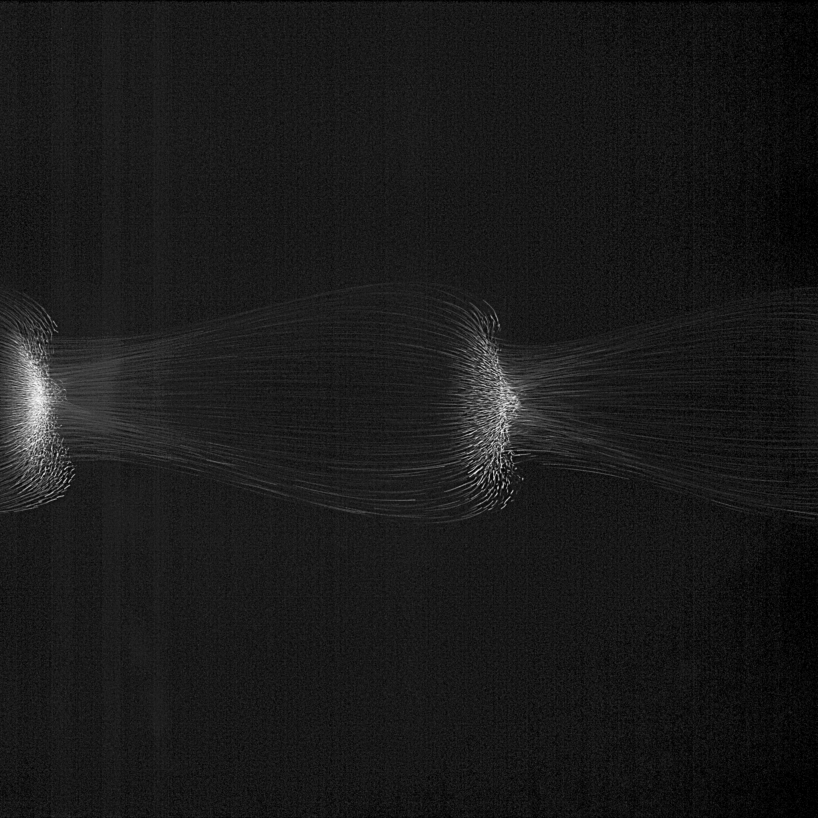
2 mm
PFC
40 Pa
2 mm
ISS
30 Pa
25 Pa
20 Pa
15 Pa

Slide 5
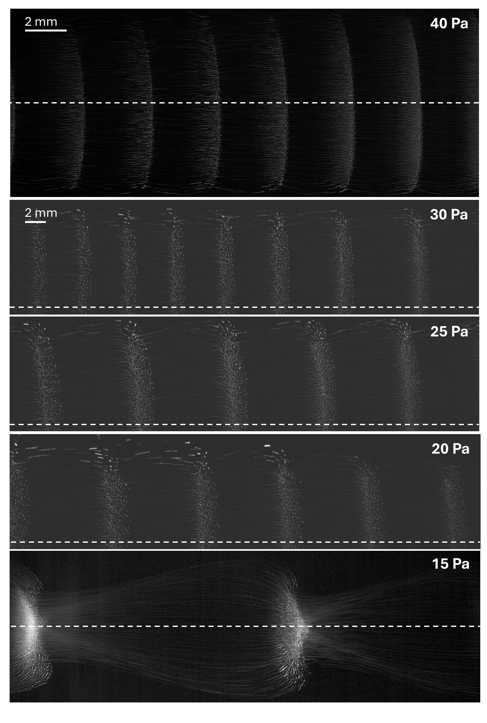
PFC
ISS

Slide 6
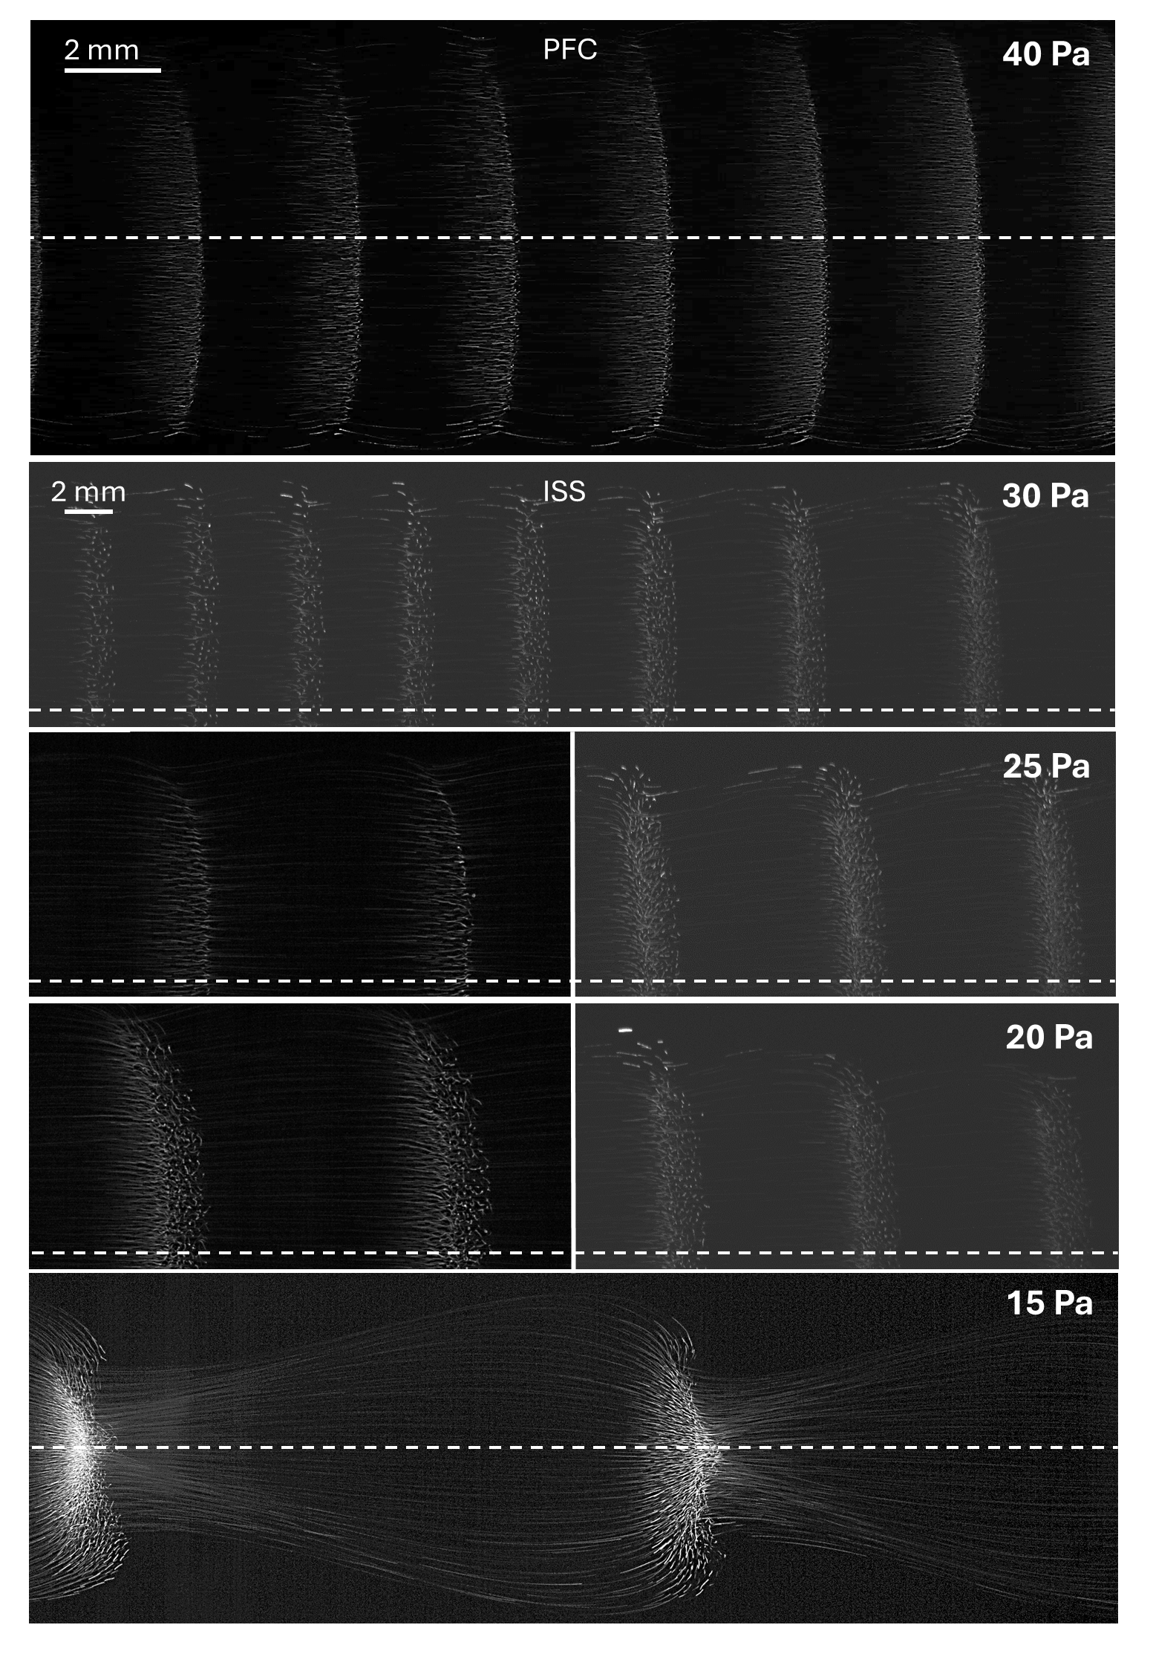

Slide 7
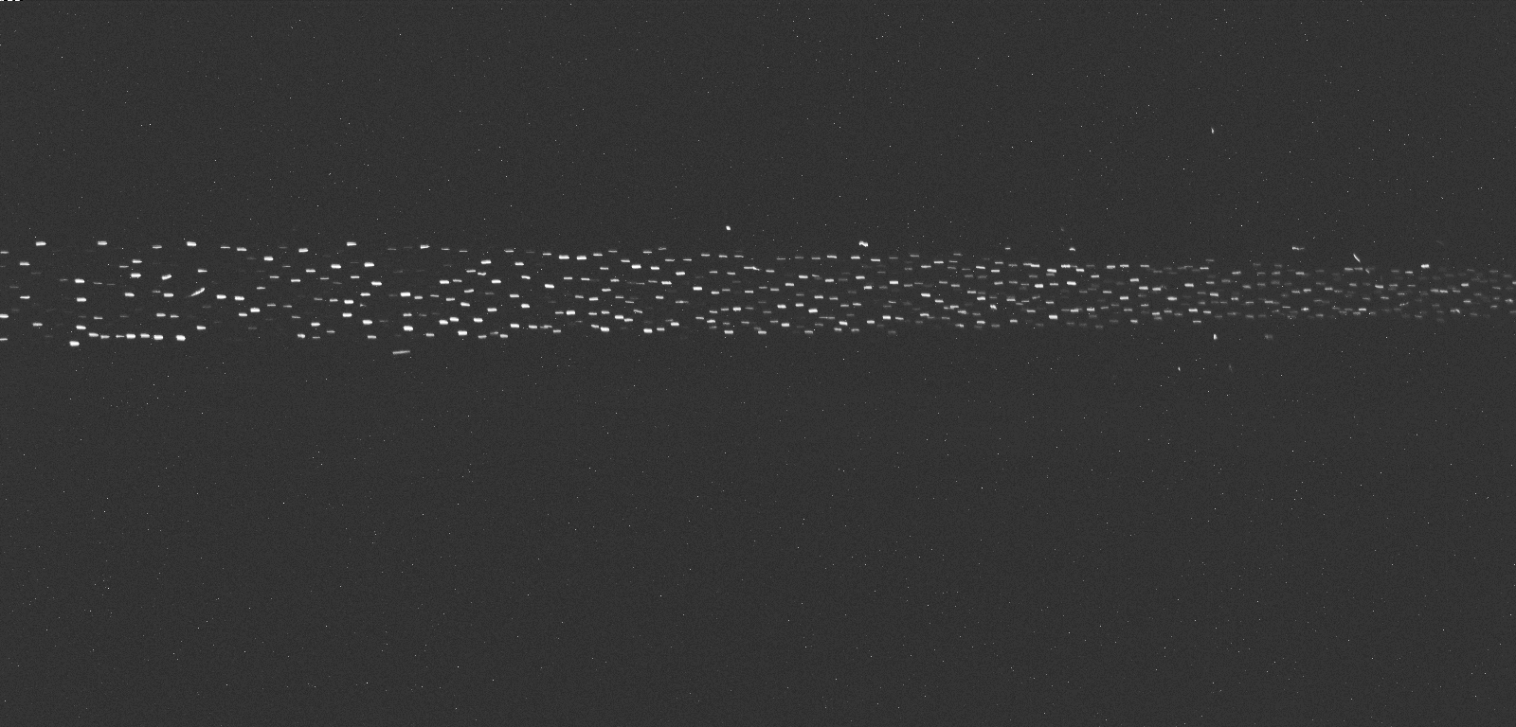
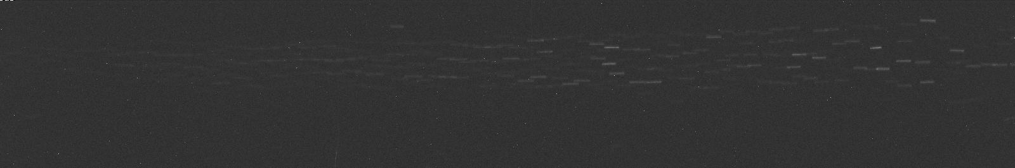
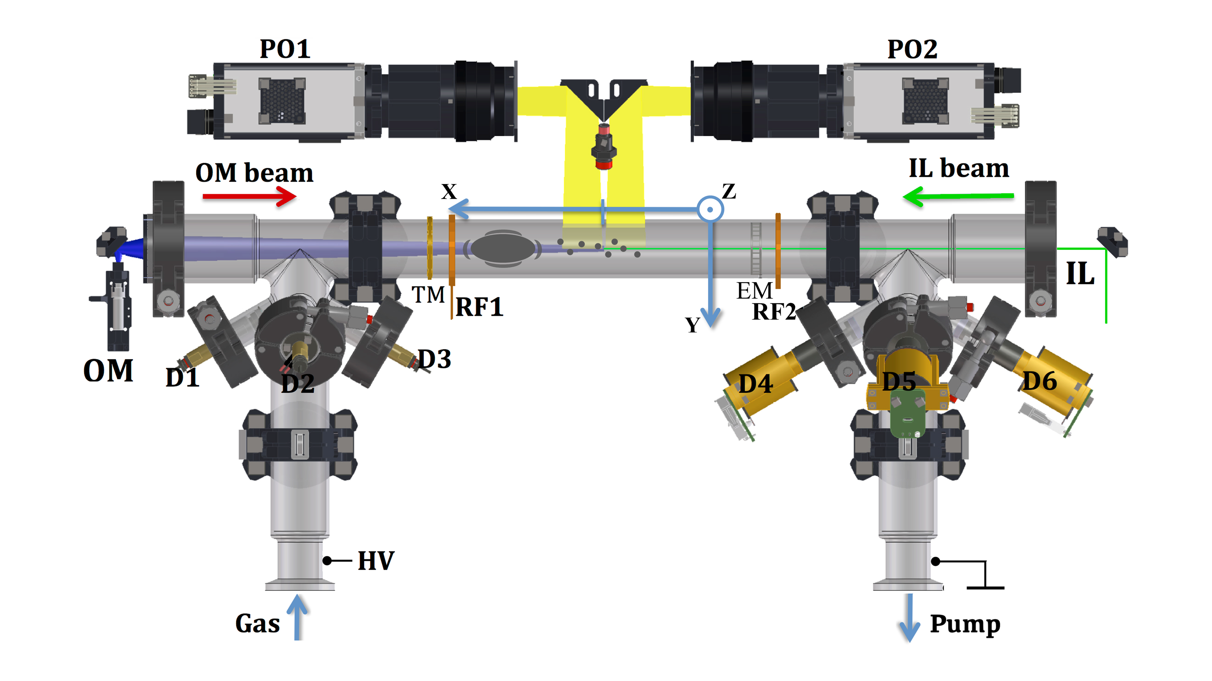
VM1
20Pa
VM2
120Pa
Neon
Argon

Slide 8
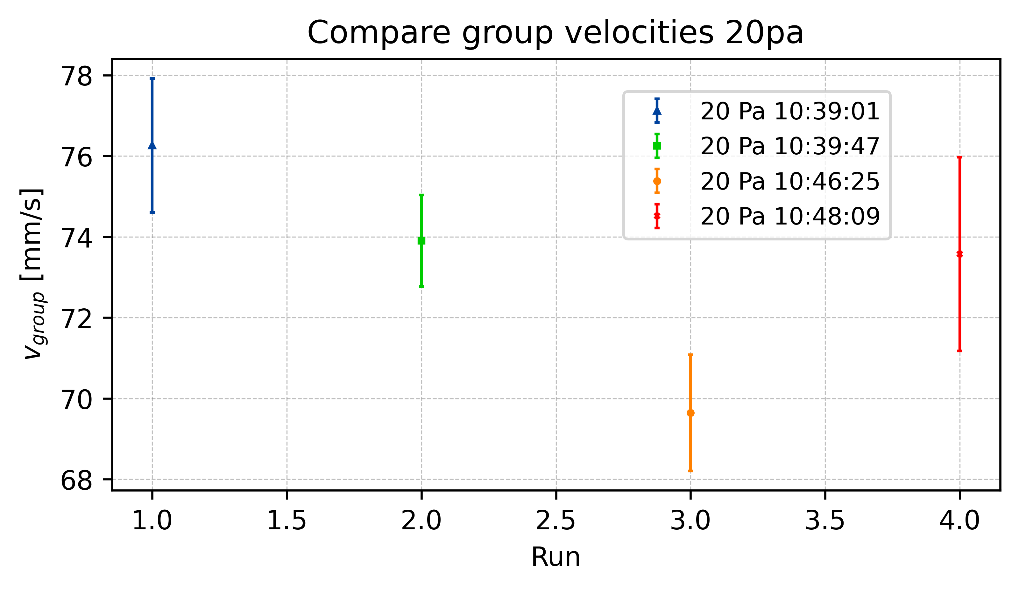
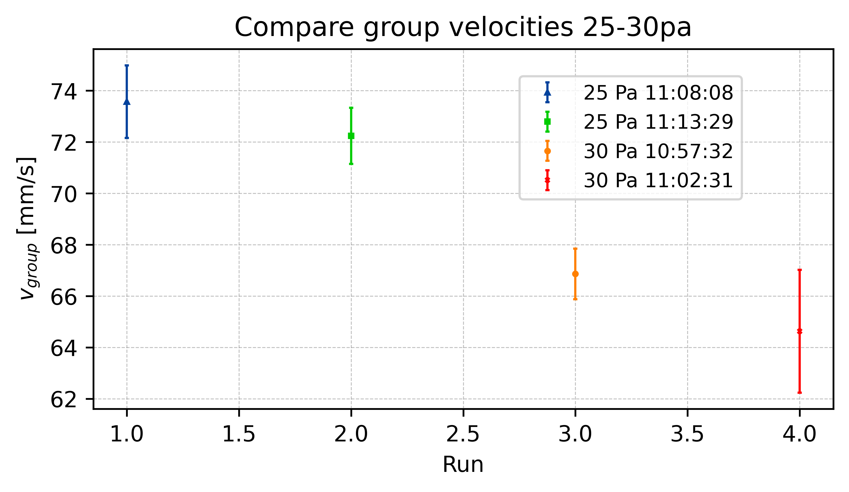
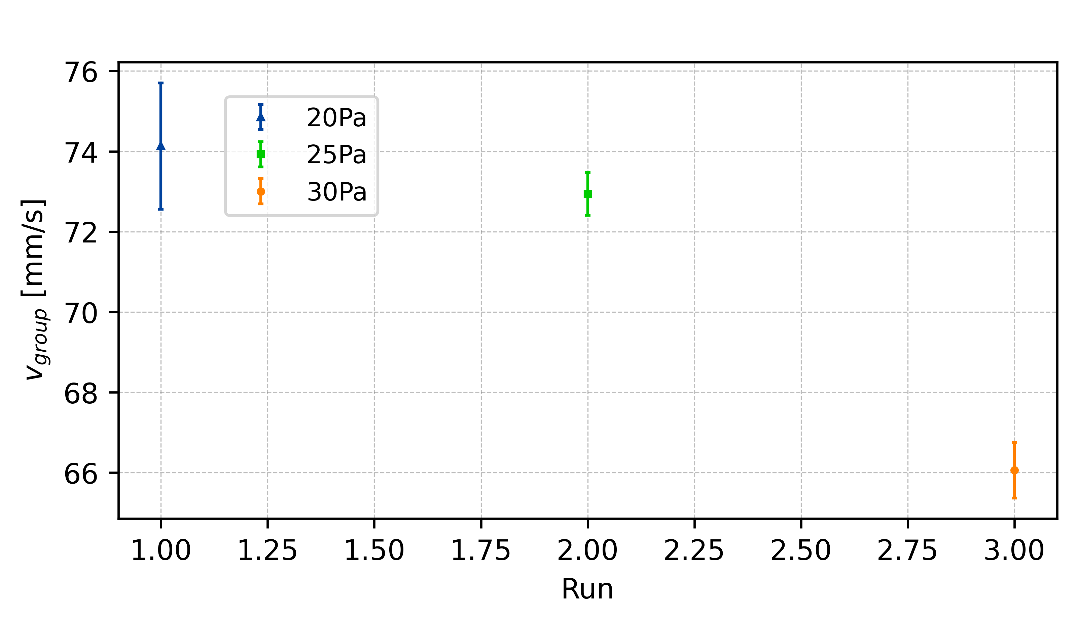
Group Velocity

Slide 9
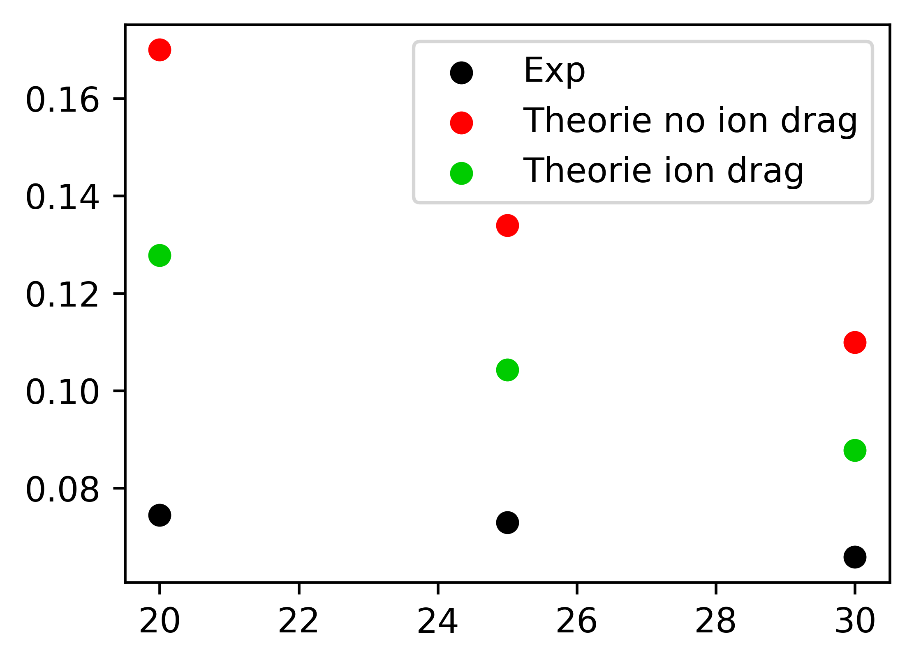
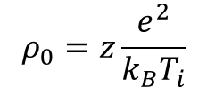
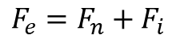
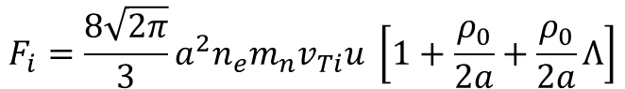
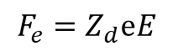
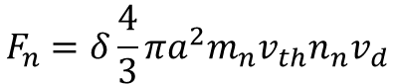
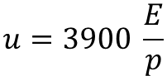
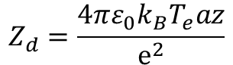
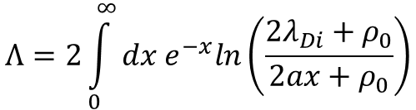
Theoretical Group Velocity
Khrapak et. al.
$$F_{e}=F_{n}+F_{i}$$
$$F_{e}=Z_{d}ⅇE$$
Z=0.345
$$F_{n}=δ\frac{4}{3}πa^{2}m_{n}v_{th}n_{n}v_{d}$$
$$F_{i}=\frac{8\sqrt{2π}}{3}a^{2}n_{e}m_{n}v_{Ti}u \left[1+\frac{ρ_{0}}{2a}+\frac{ρ_{0}}{2a}Λ\right]$$
$$ρ_{0}=z\frac{e^{2}}{k_{B}T_{i}}$$
$$Λ=2\int_{0}^{∞}{dx e^{−x}ln\left(\frac{2λ_{Di}+ρ_{0}}{2ax+ρ_{0}}\right)}$$
$$u=3900 \frac{E}{p}$$
$$Z_{d}=\frac{4πε_{0}k_{B}T_{e}az}{ⅇ^{2}}$$

Slide 10
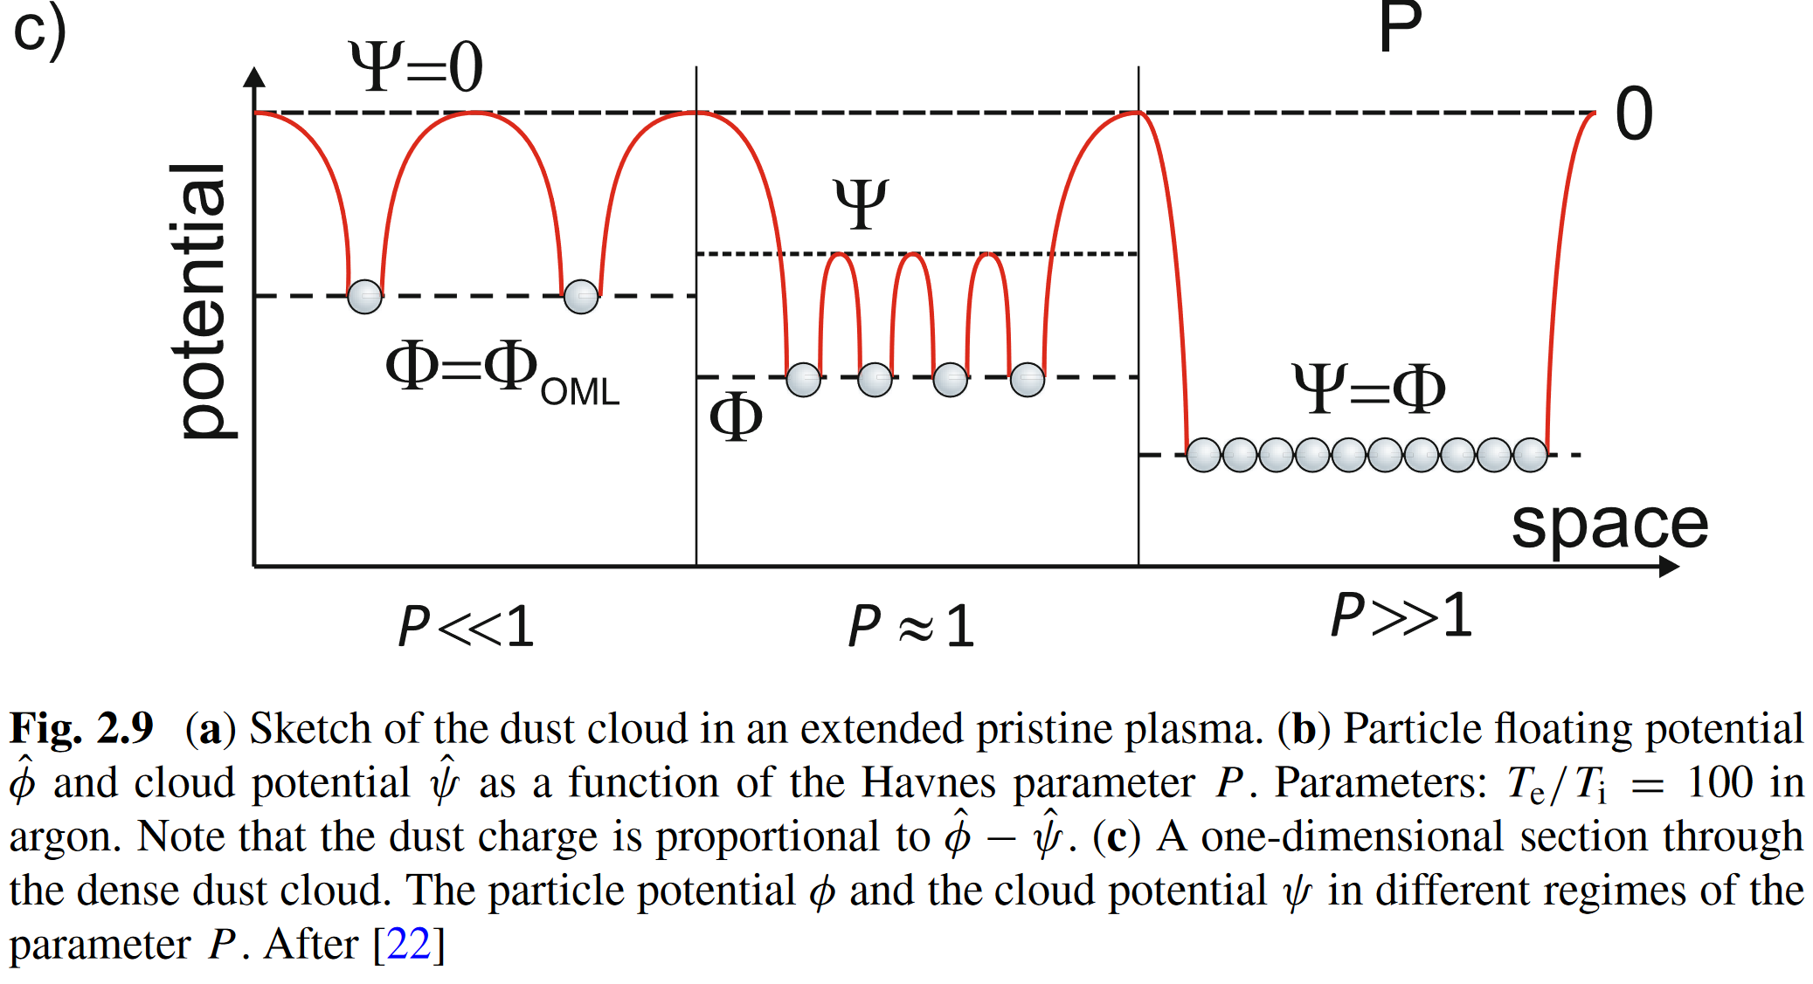
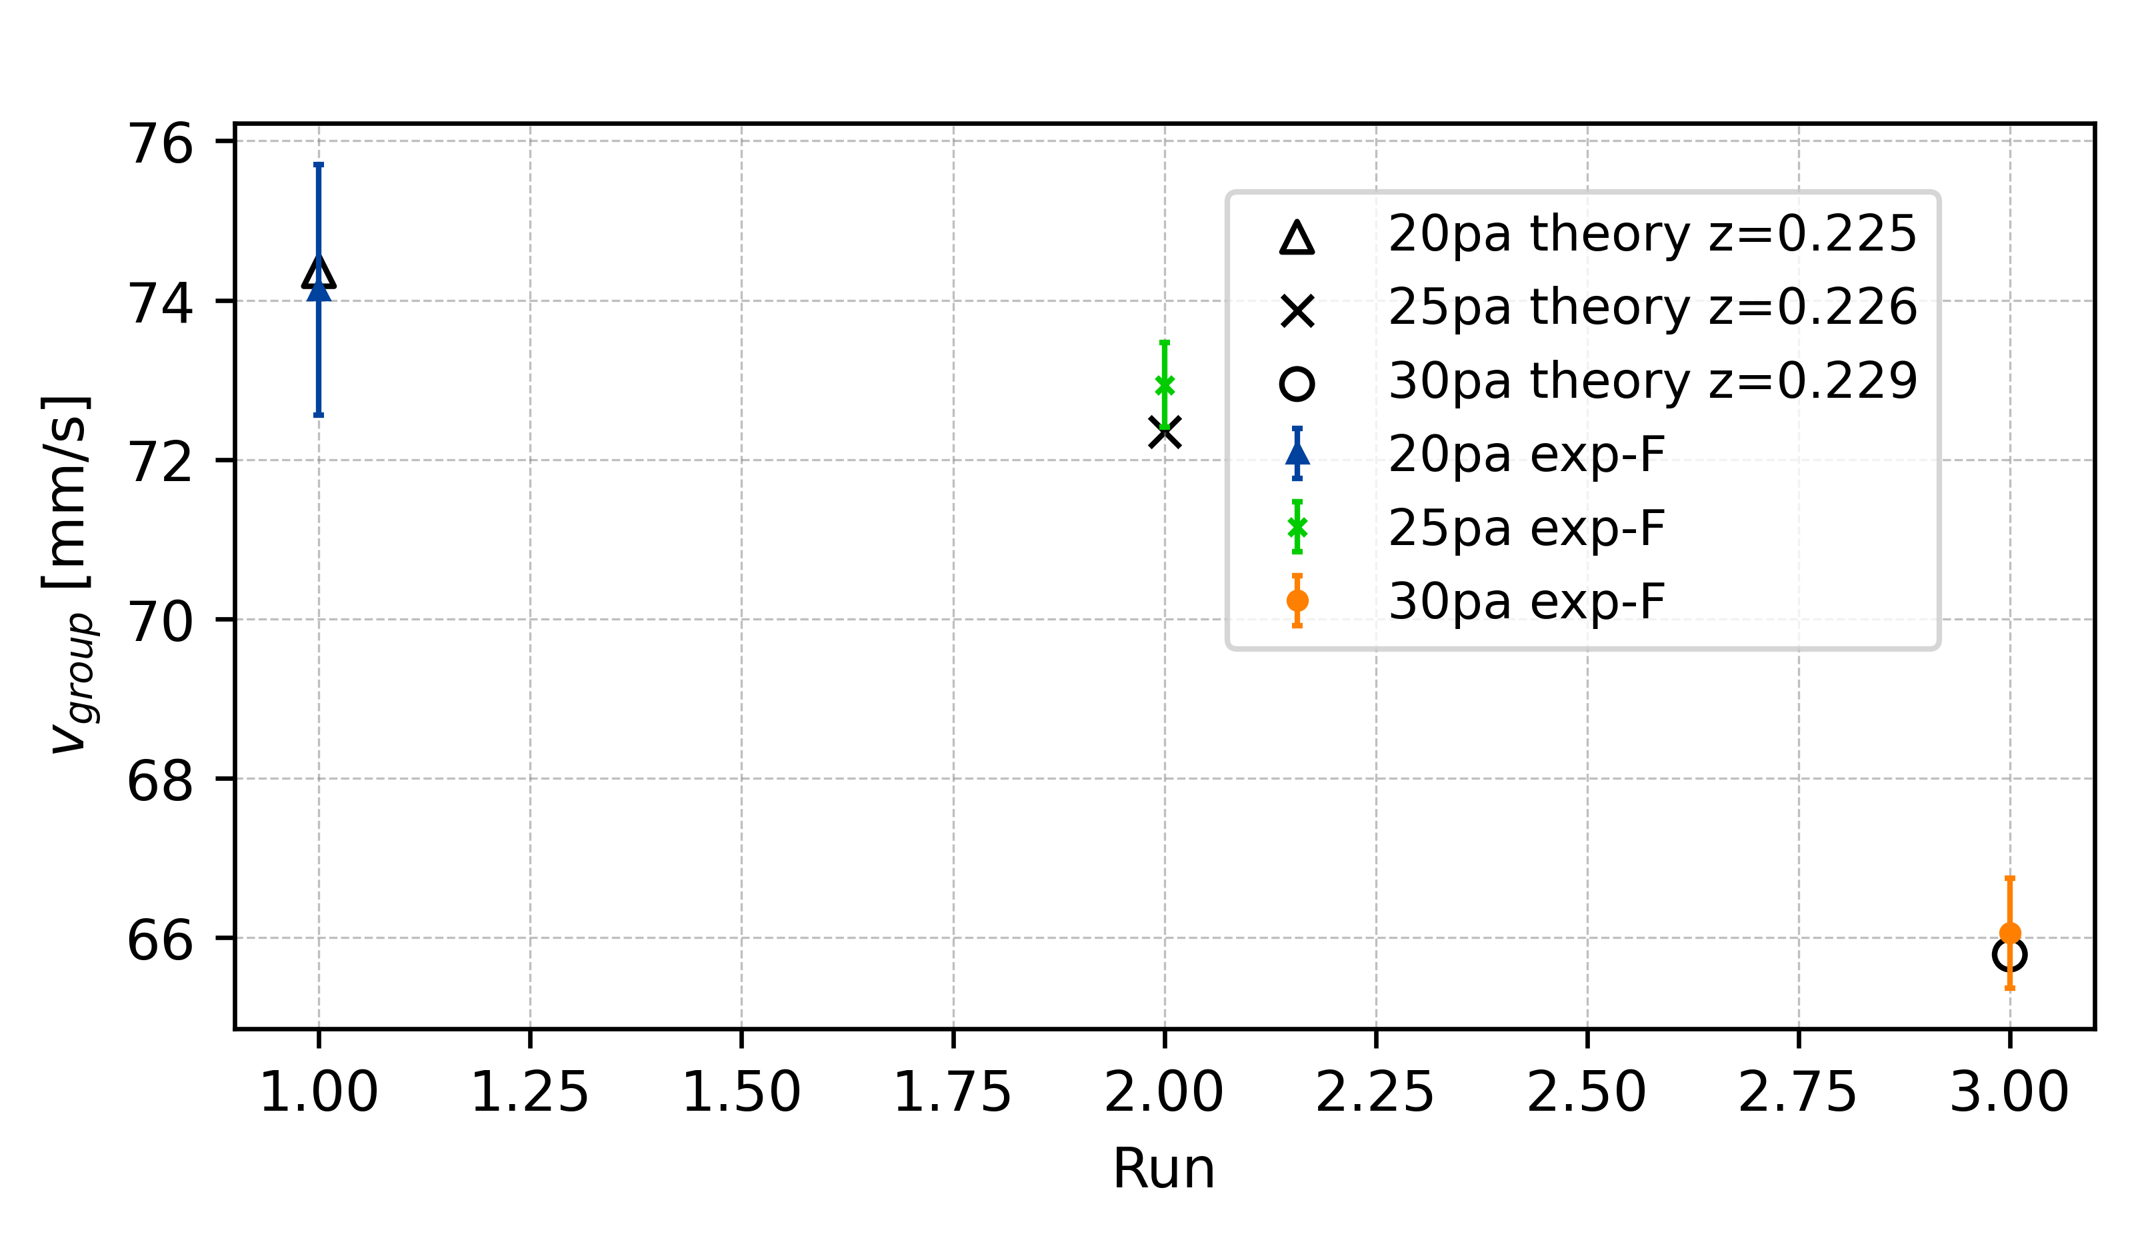
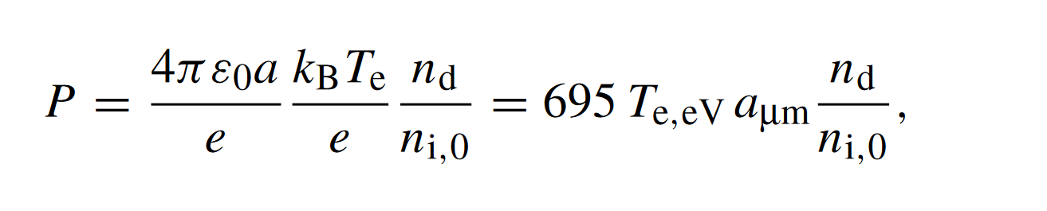
Charge Depletion – Havnes Parameter
[20Pa, 25Pa, 30Pa]
[2.047, 1.967, 1.899, 1.838]
New z from depletion theory

Slide 11
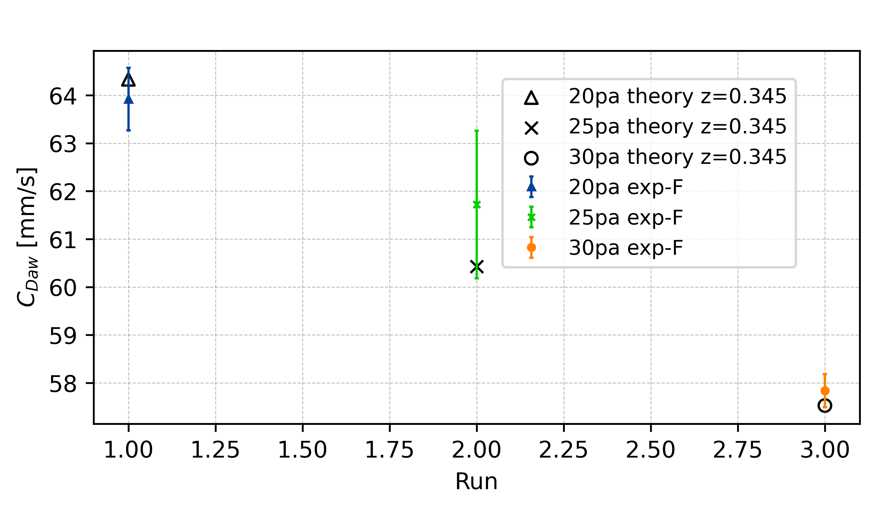
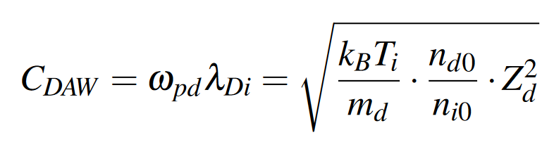
Dust-accoustic wave phase speed – C_{DAW}
Charge depletion is not playing a role in wave propagation
Charge reduction of individual particle is trigger effect of collective wave phenomena

Slide 12
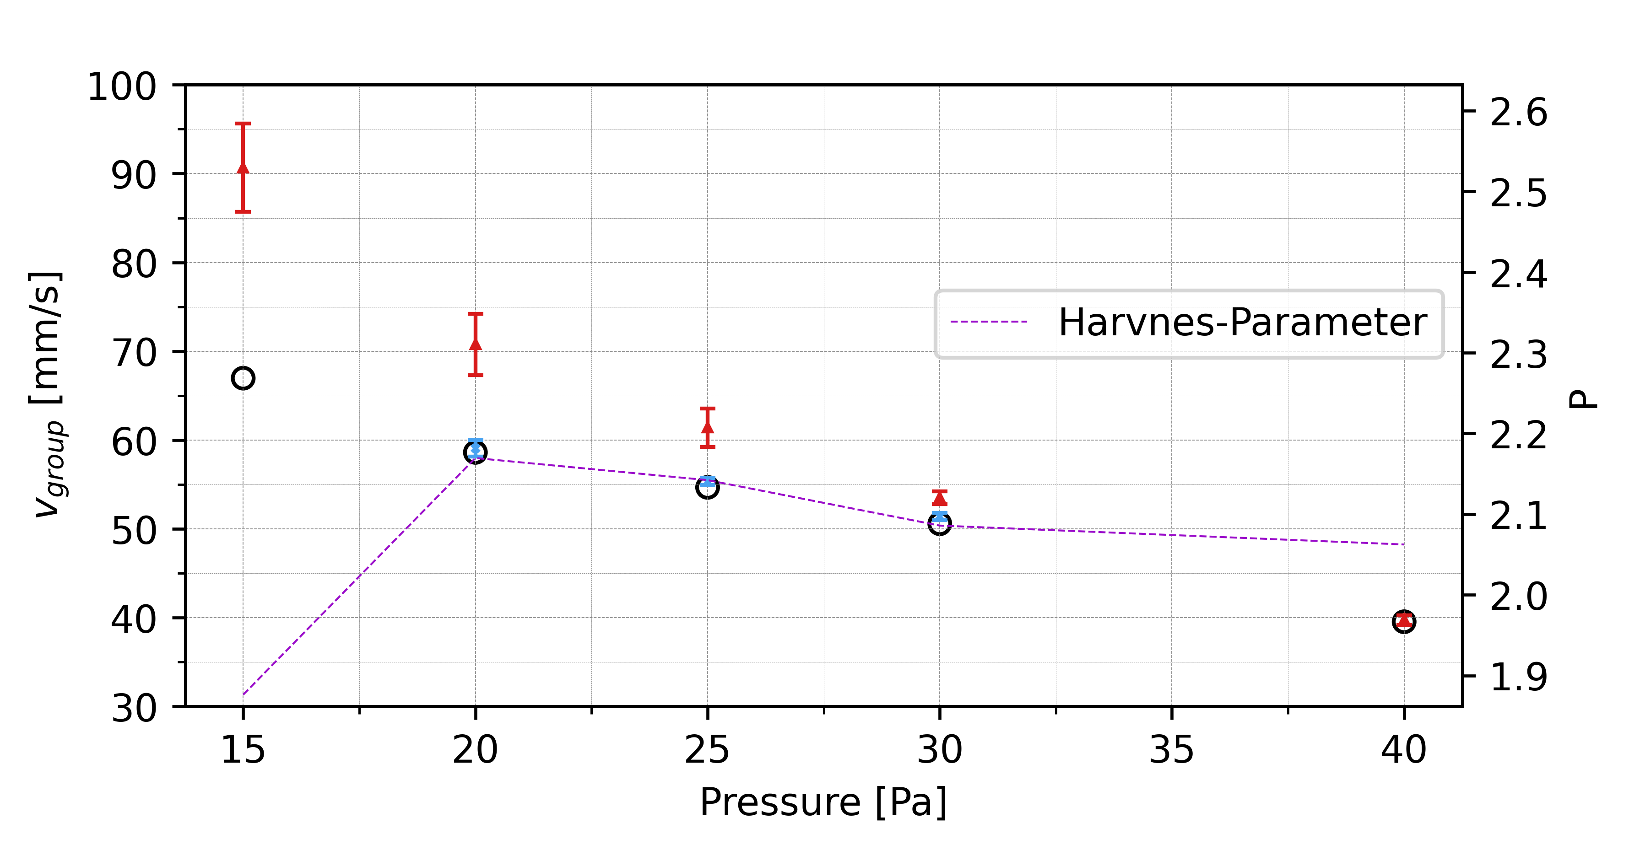
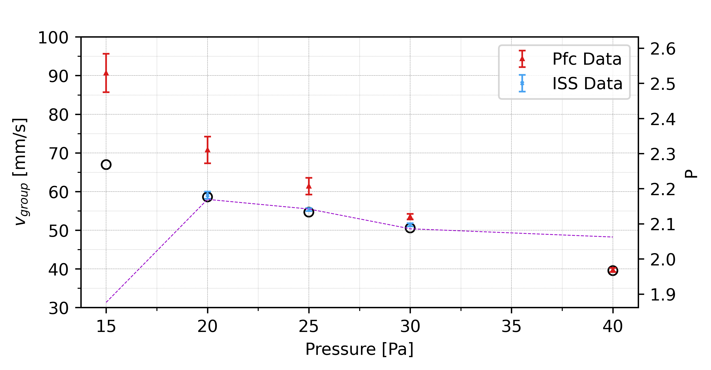
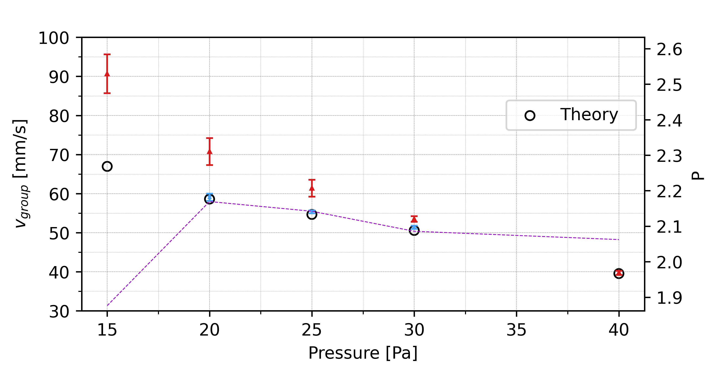

Slide 13
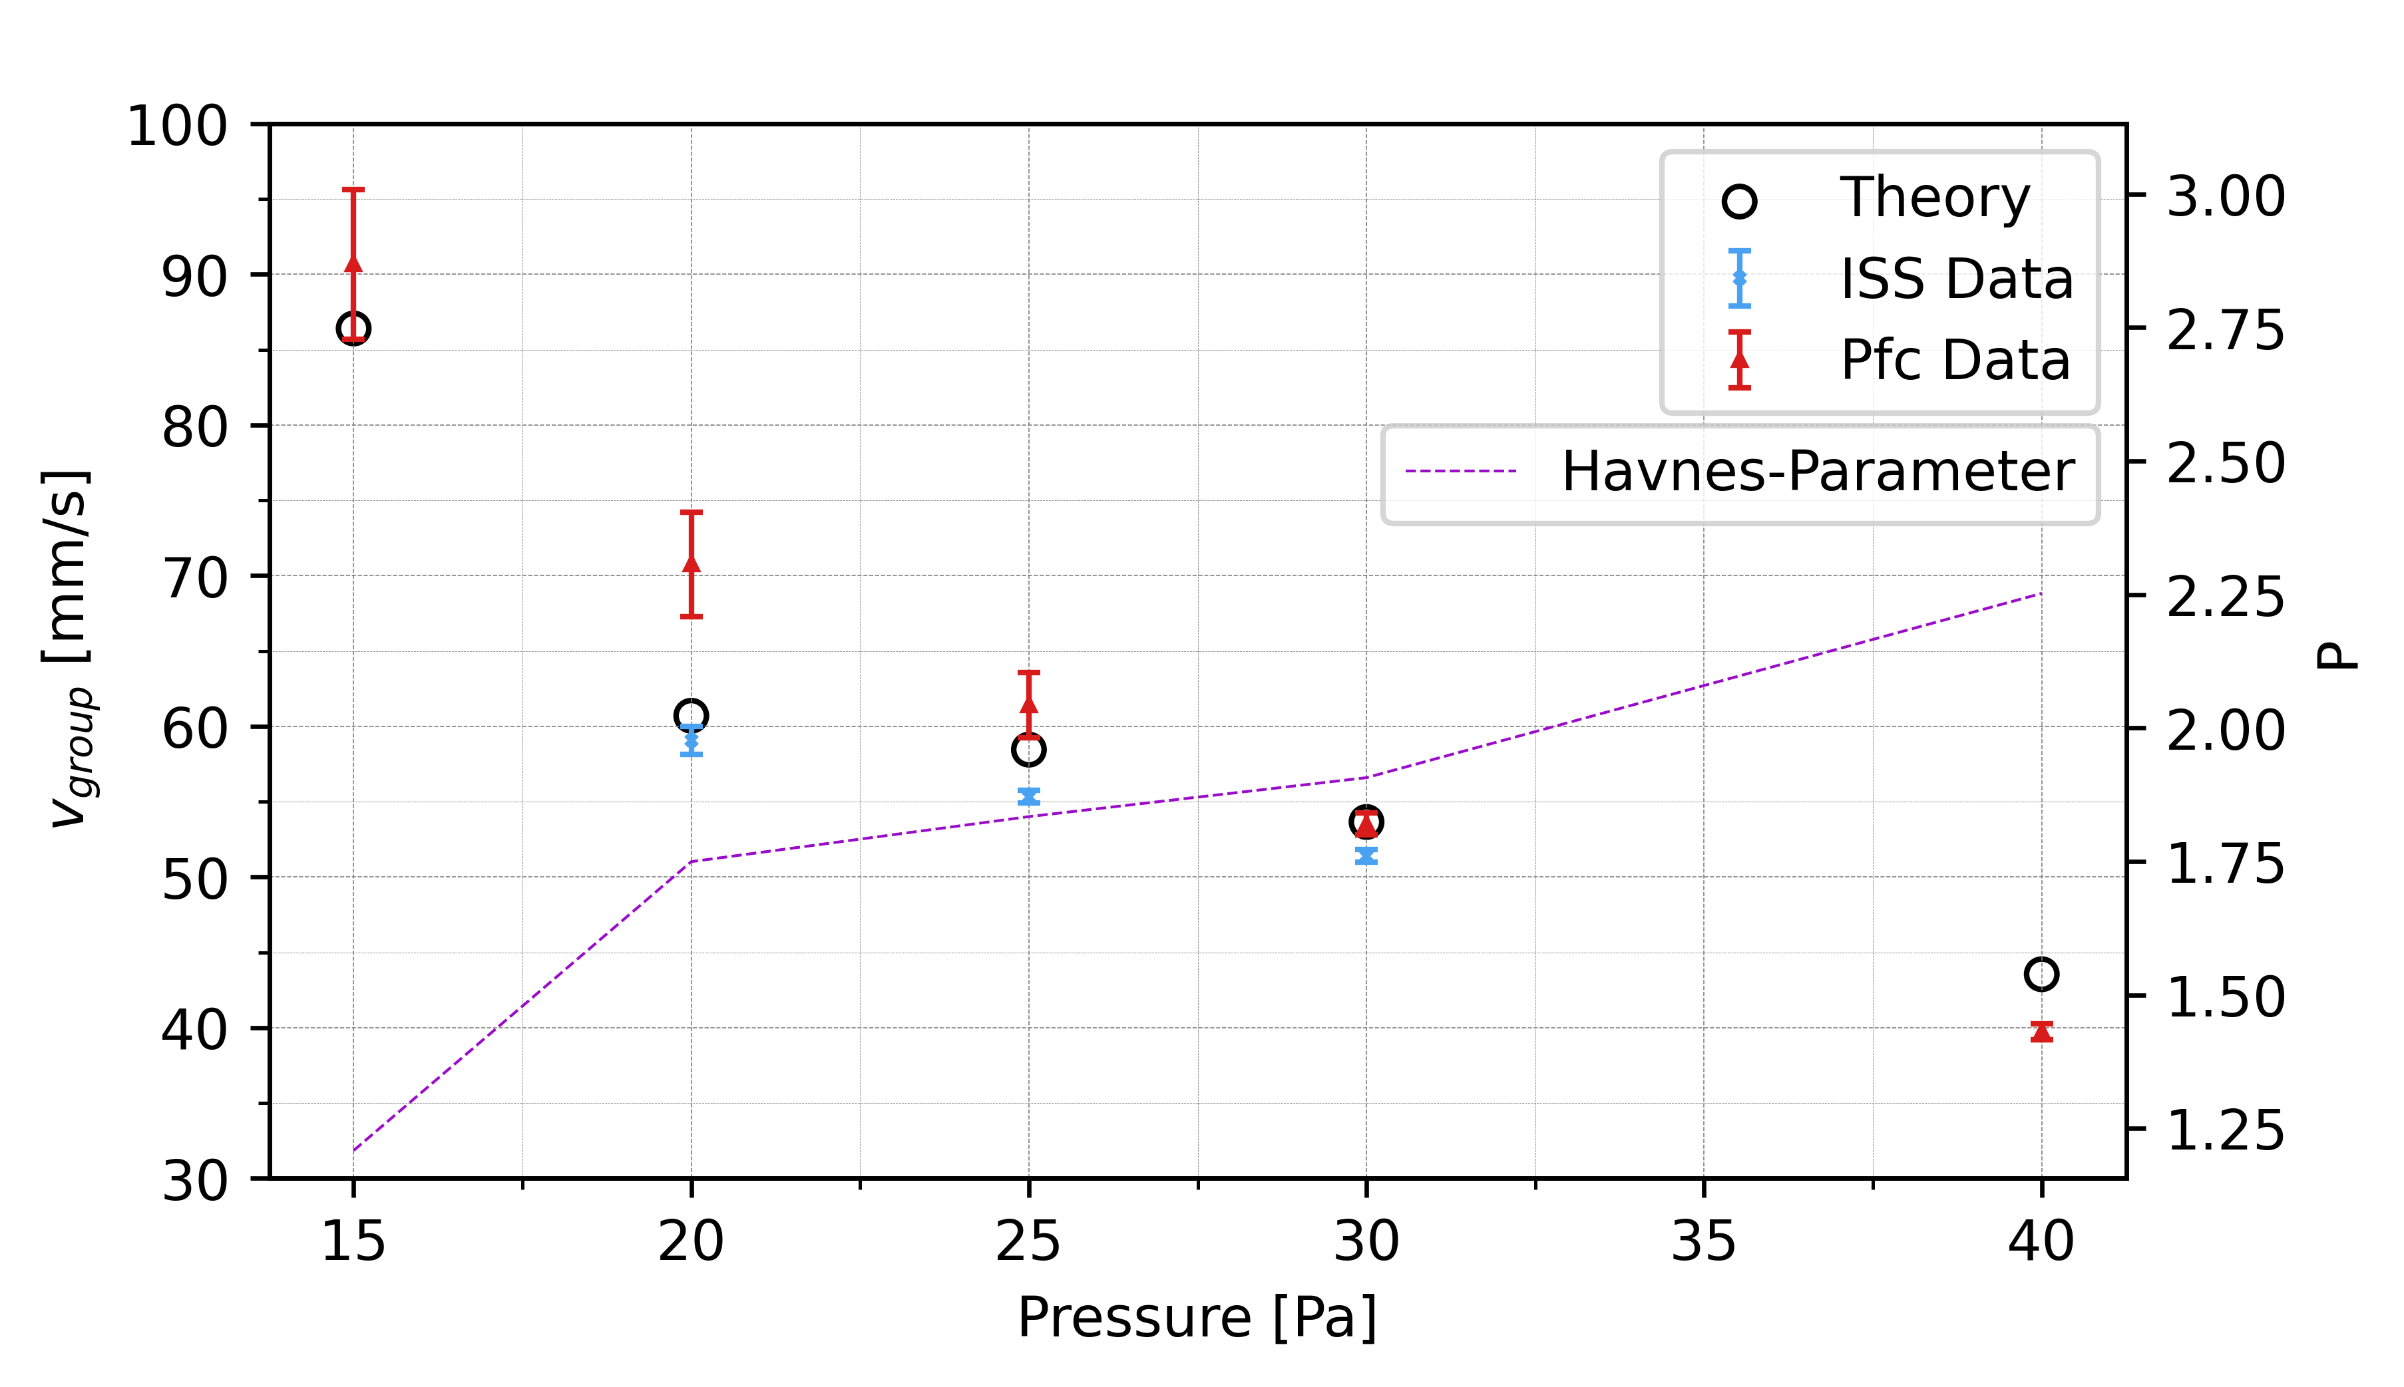
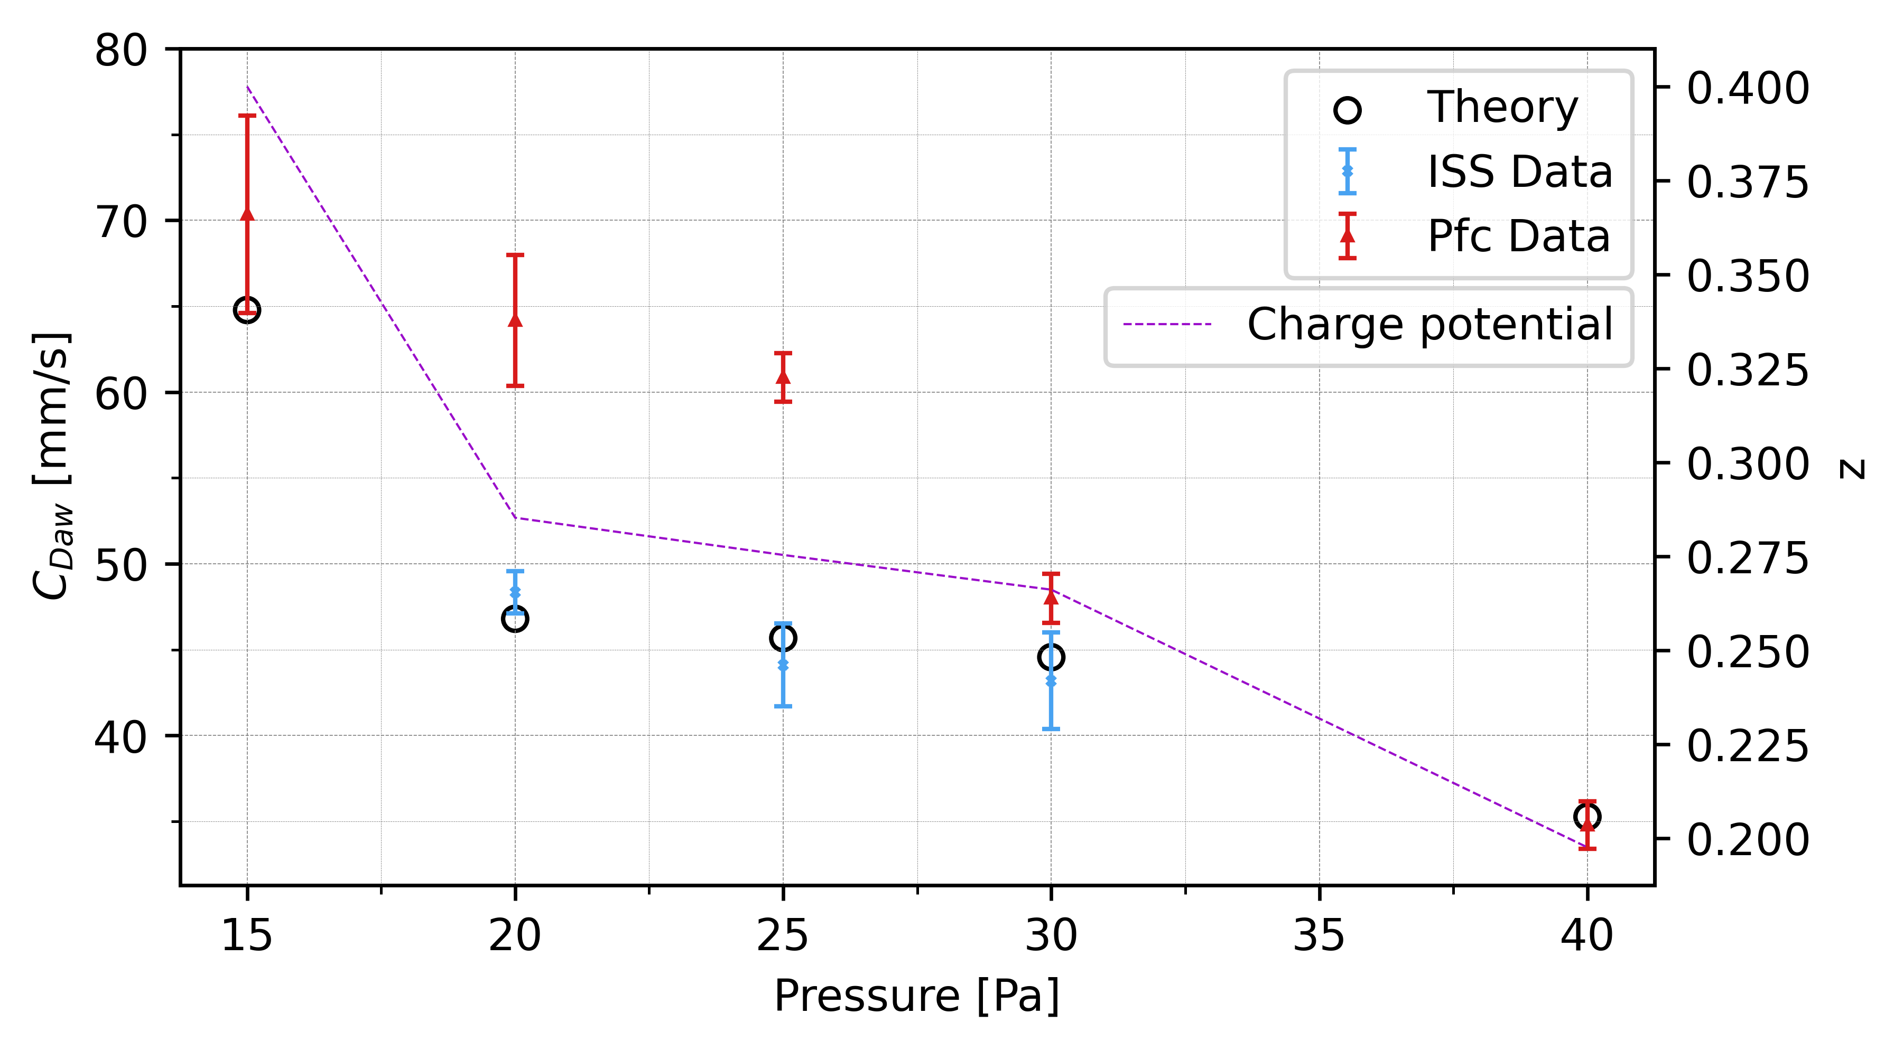

Slide 14
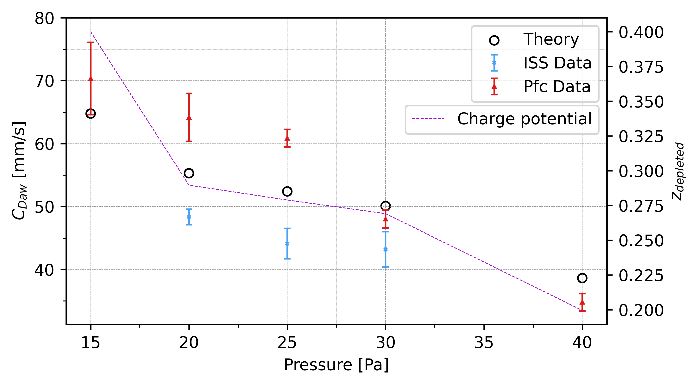

Slide 15
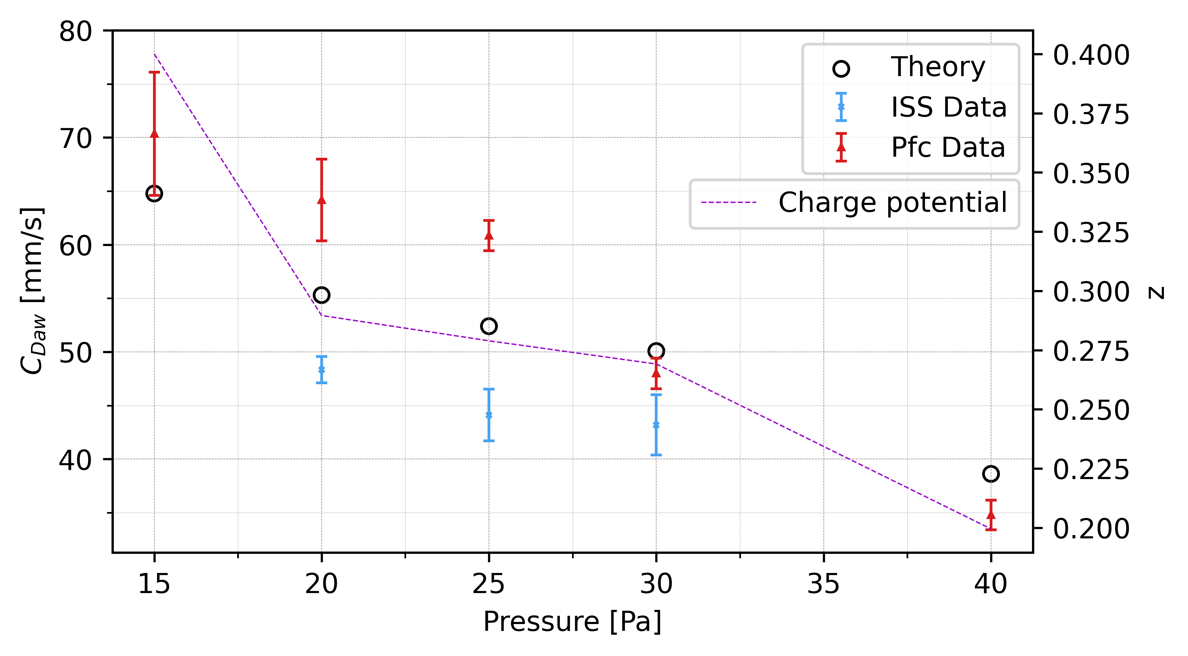
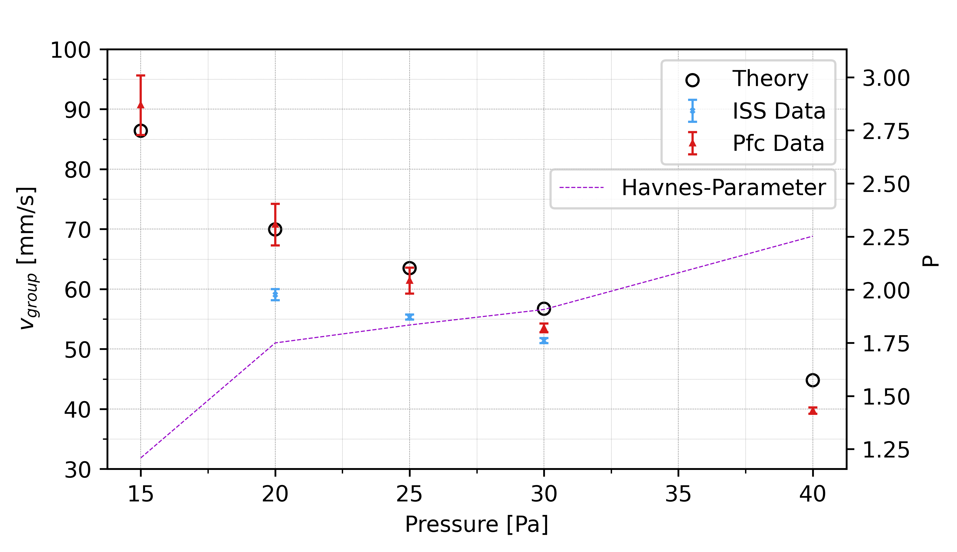

Slide 16
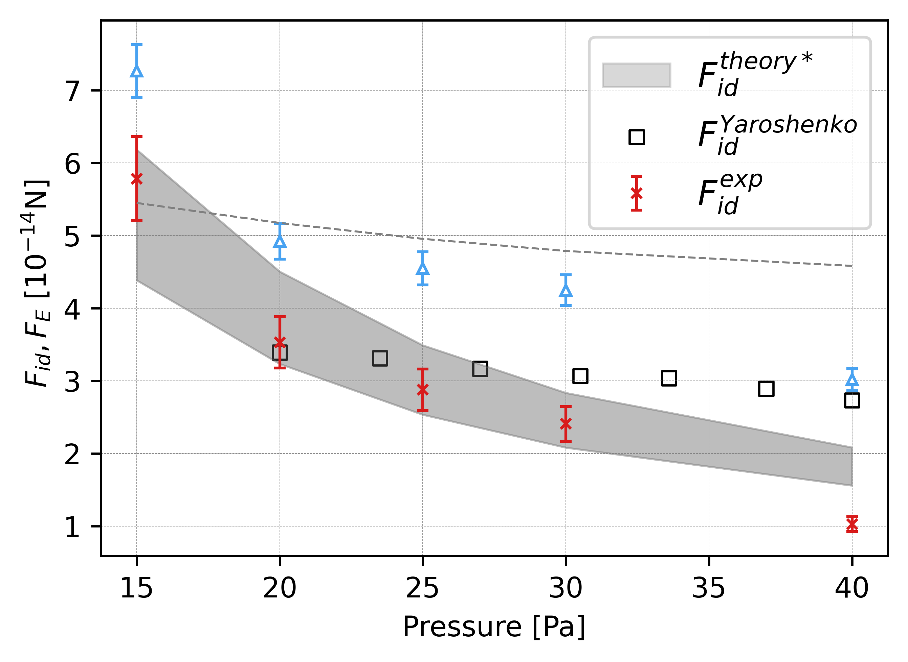
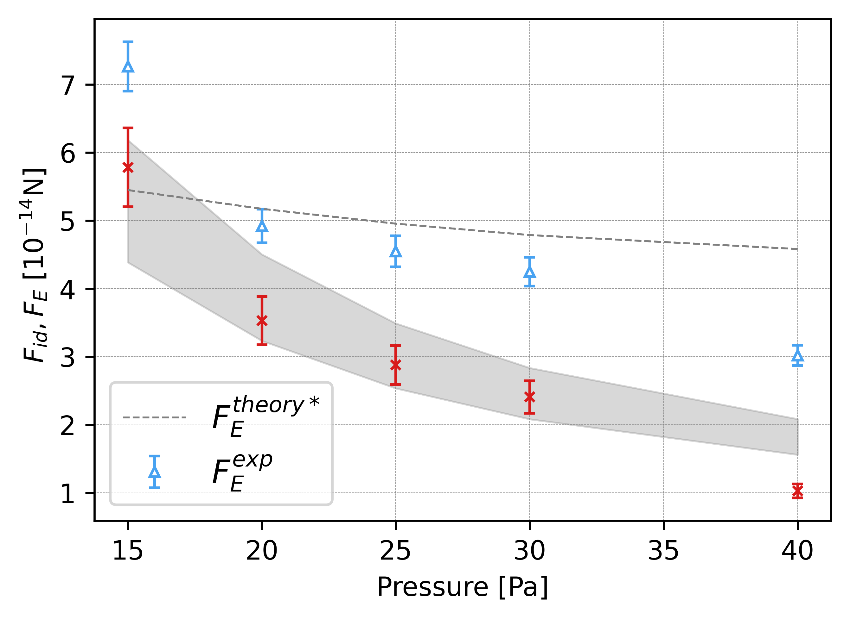

Slide 17
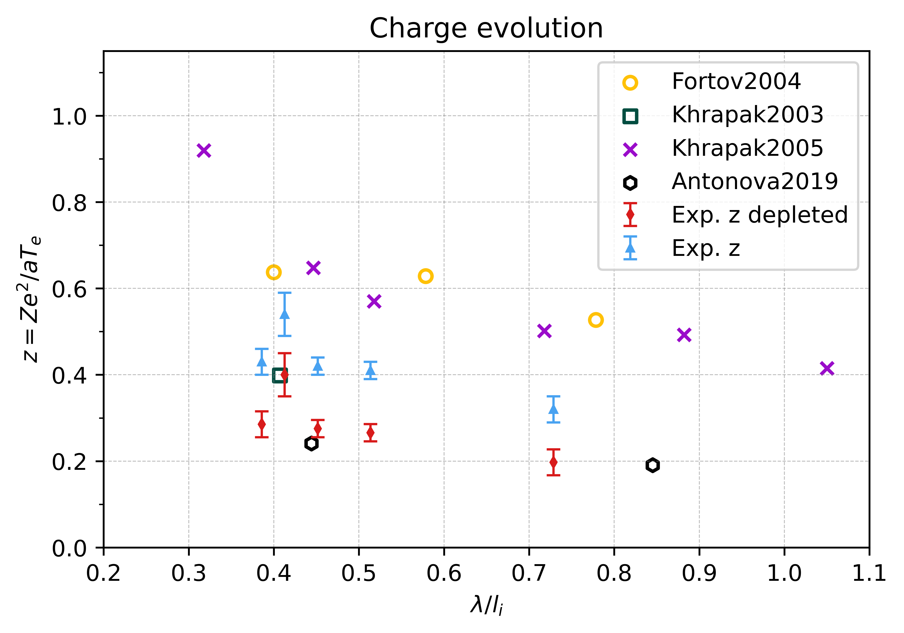
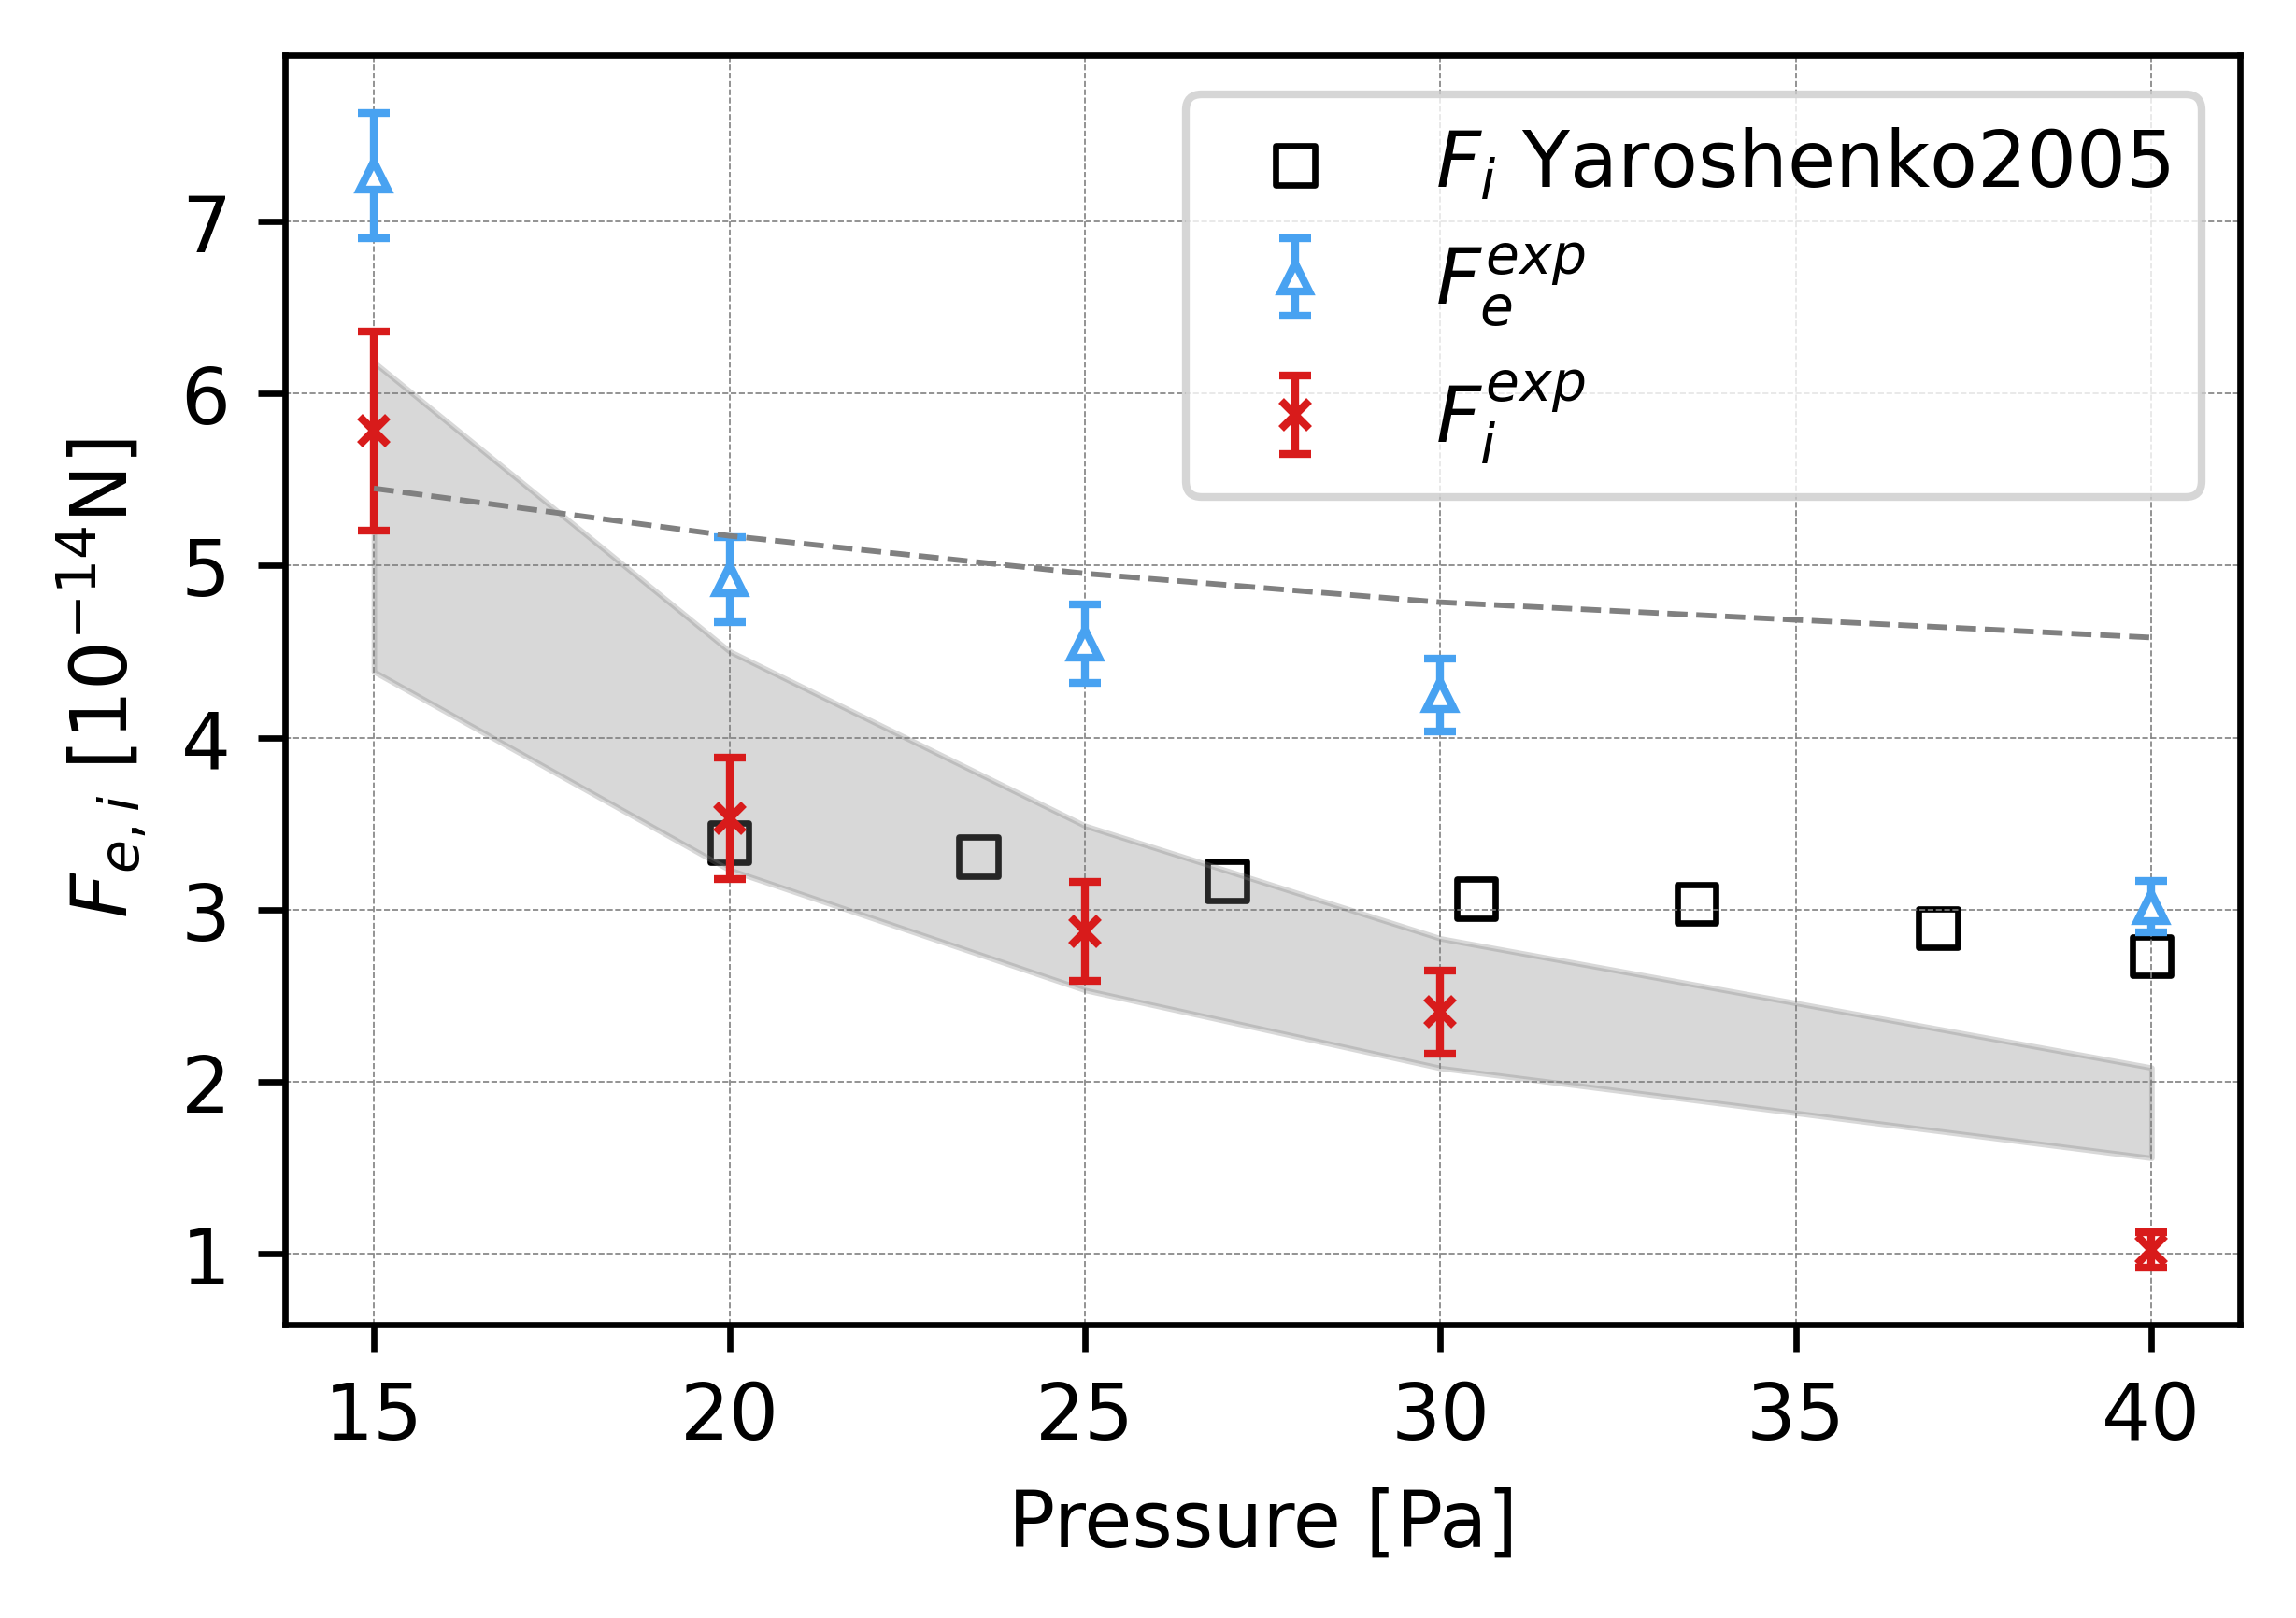

Slide 18
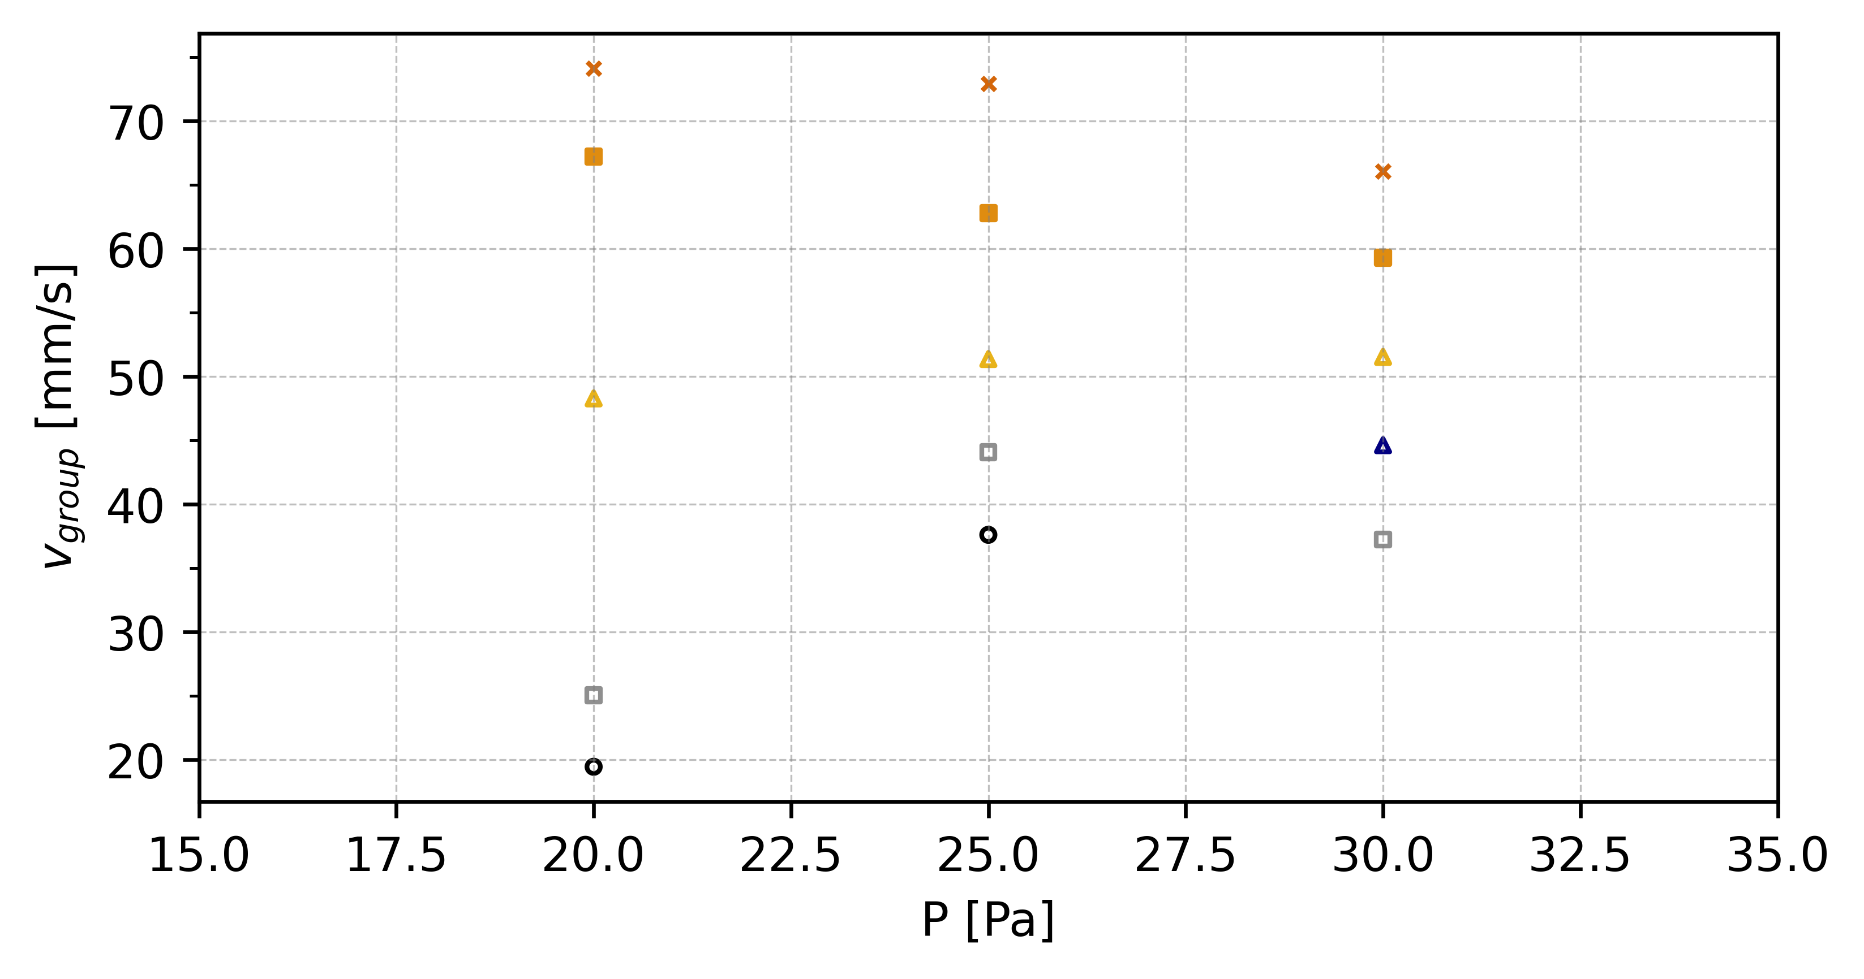
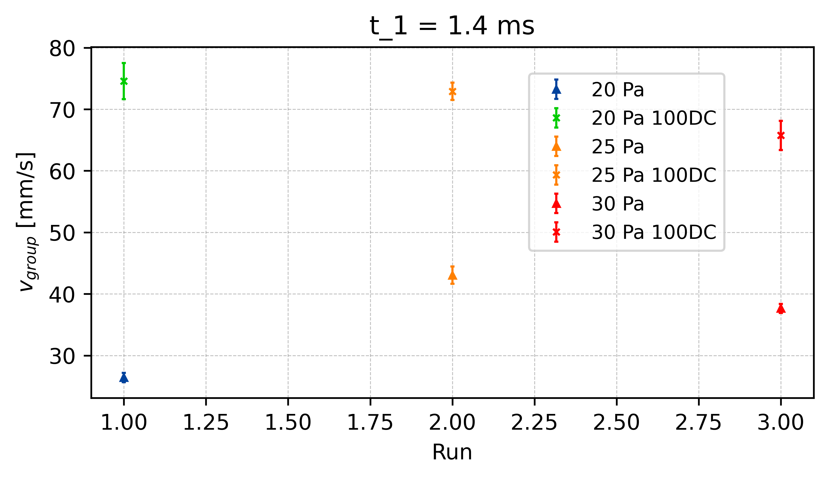
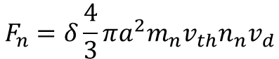
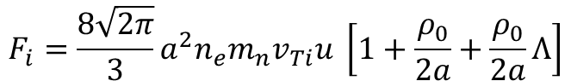
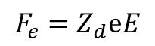
Reduction of Electric Field - v_{group}
t = 1.3ms
E_{effectiv} = 30%
100%
t = 1.4ms
E_{effectiv} = 40%
t1.4
80%
t = 1.5ms
E_{effectiv} = 50%
60%
t1.4
∆v_{25_t1.4}
t1.4
50%
∆v_{20_t1.4}
∆v_{30_t1.4}
$$F_{e}=Z_{d}ⅇE$$
40%
x E_eff
30%
$$F_{n}=δ\frac{4}{3}πa^{2}m_{n}v_{th}n_{n}v_{d}$$
$$F_{i}=\frac{8\sqrt{2π}}{3}a^{2}n_{e}m_{n}v_{Ti}u \left[1+\frac{ρ_{0}}{2a}+\frac{ρ_{0}}{2a}Λ\right]$$
x E_eff
x E_eff
Vergleiche: V_g vs P und V_g vs E

Slide 19
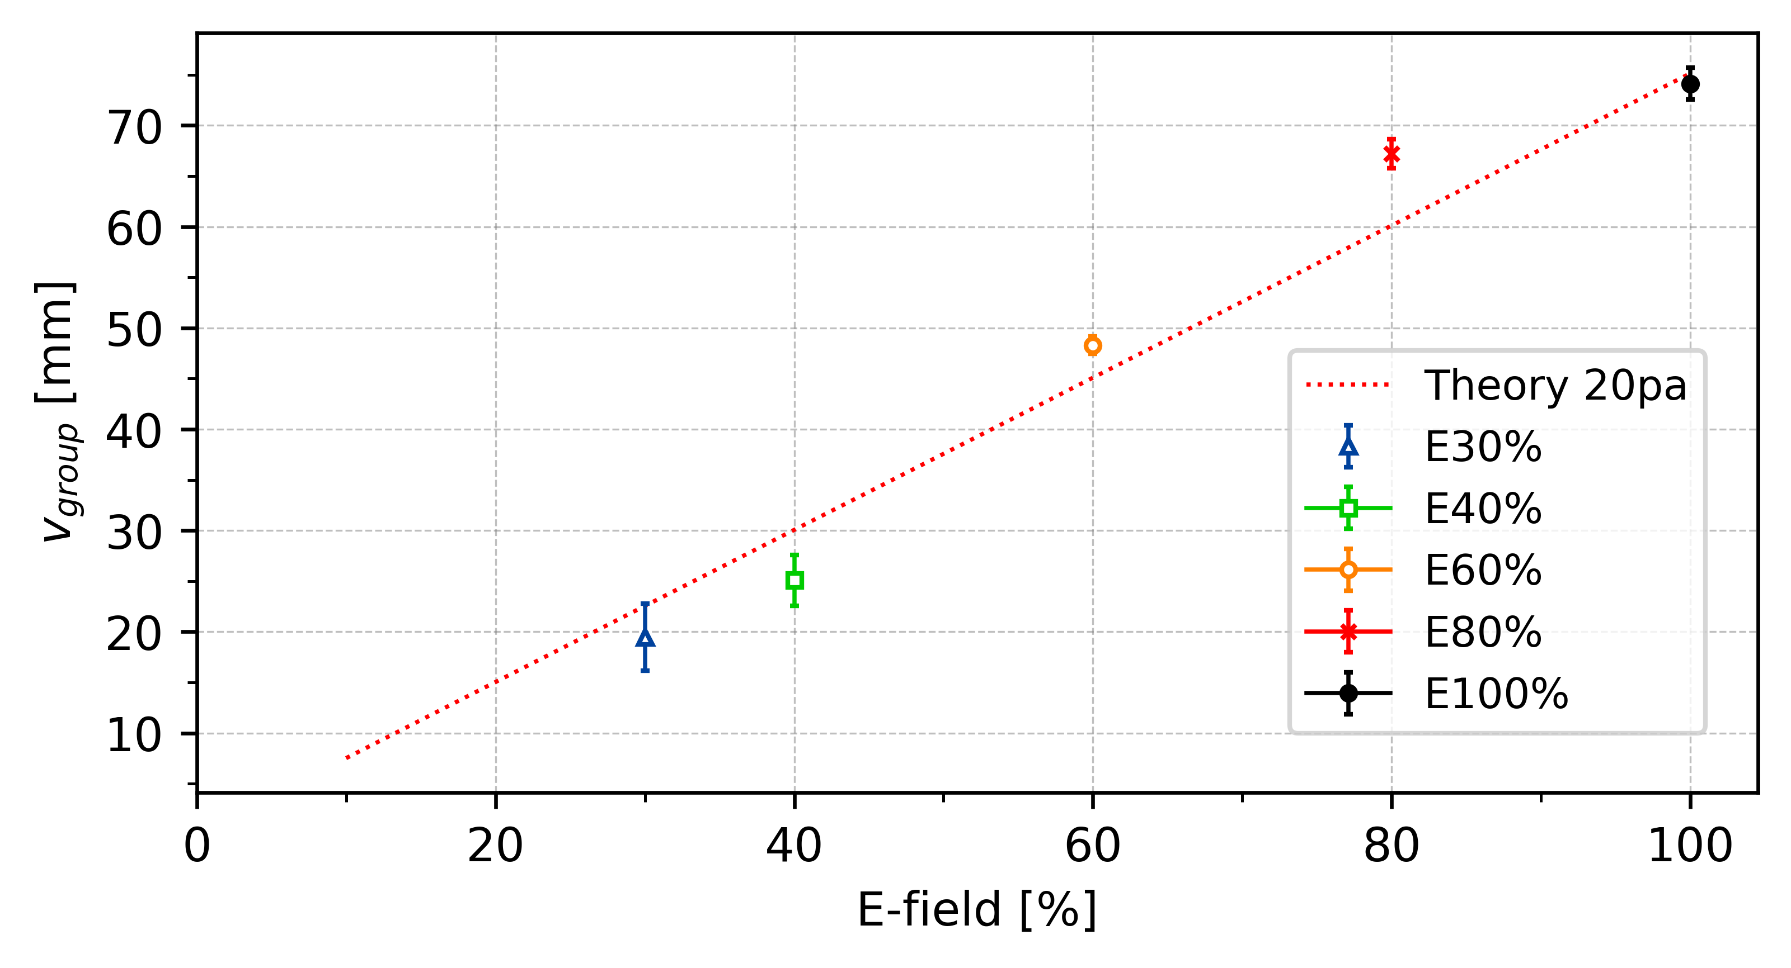
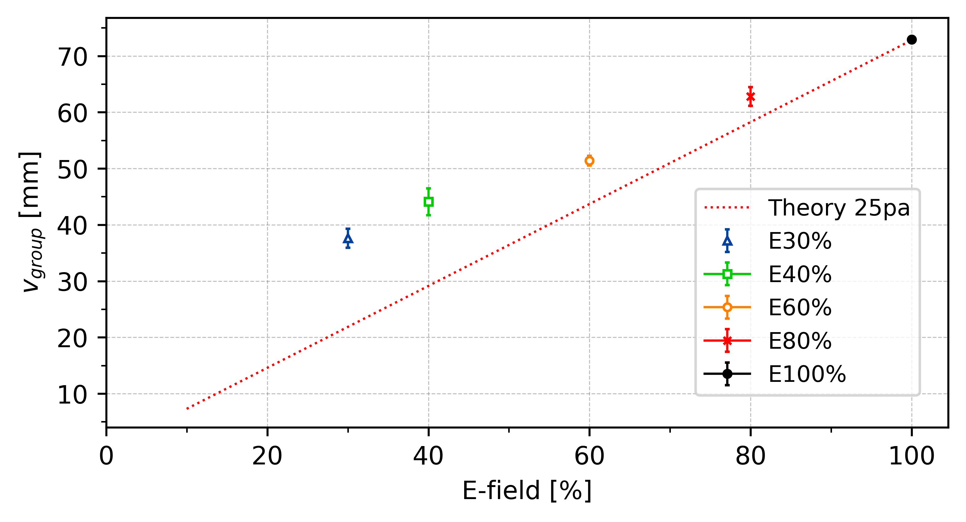
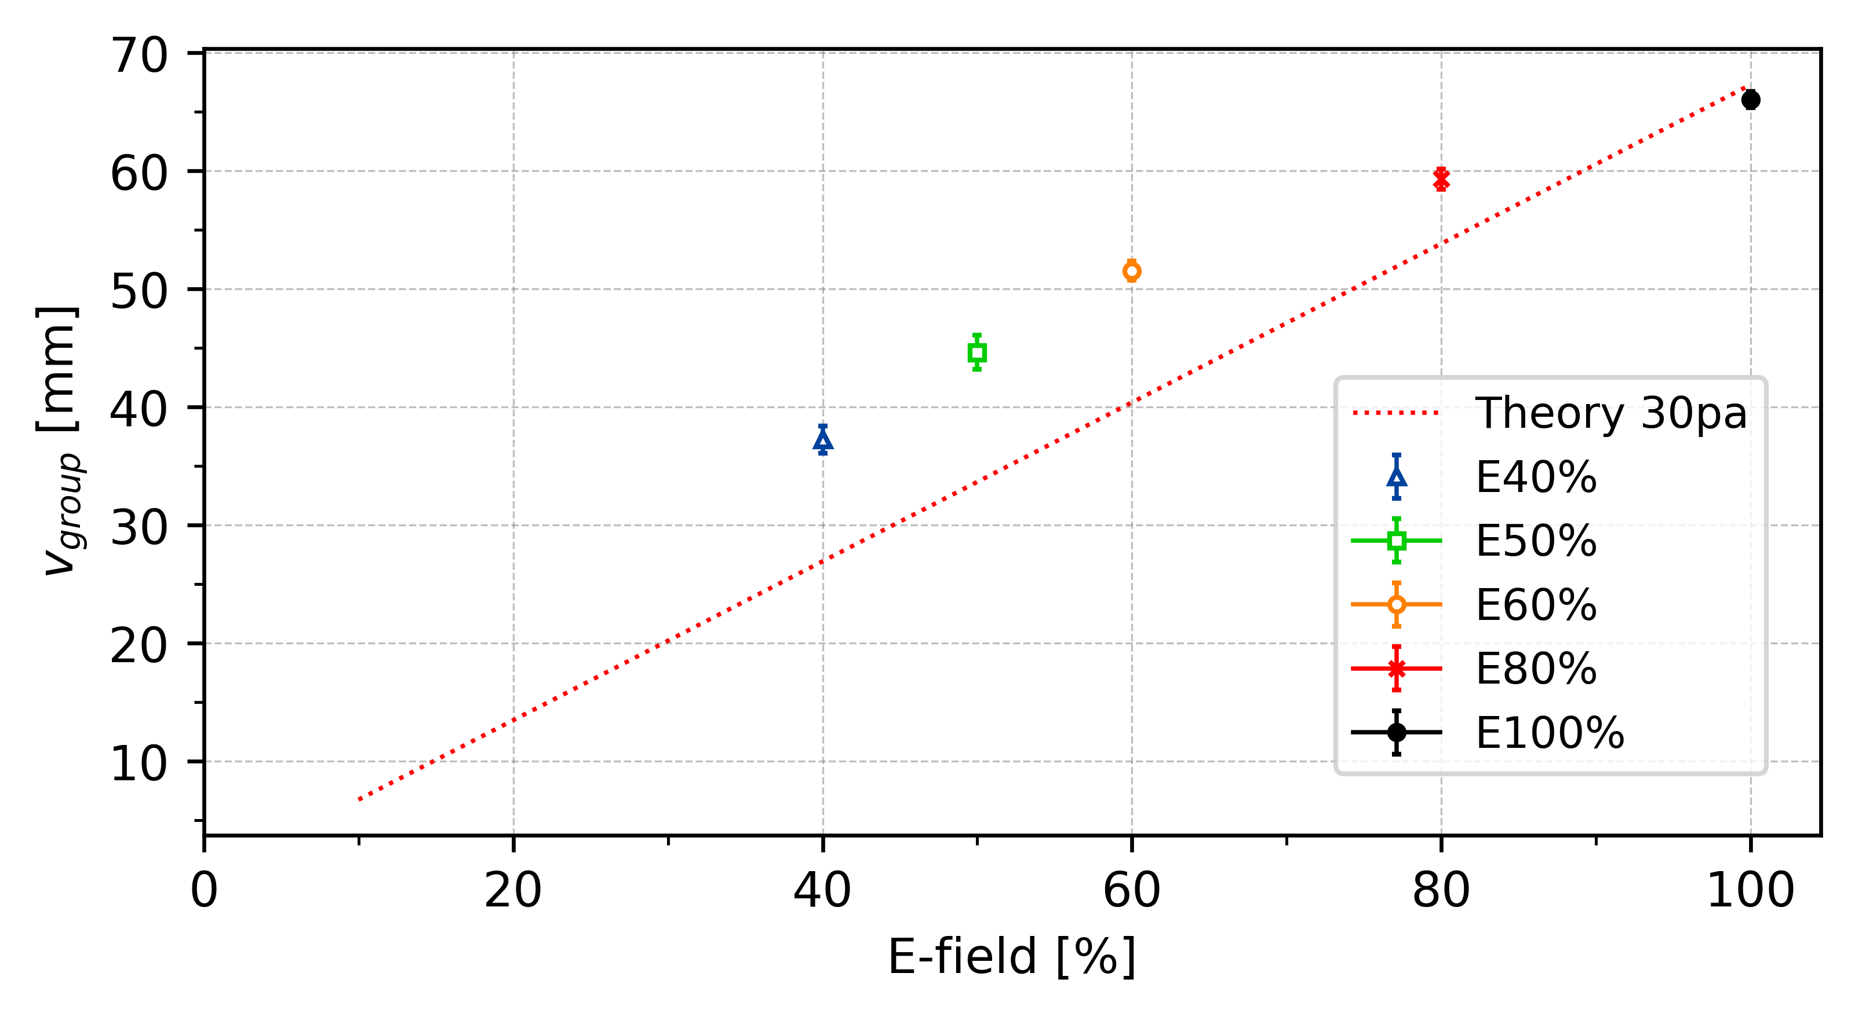




Reduction of Electric Field - v_{group}
. . .
t = 1.3ms
E_{eff} = 30%
$$F_{e,eff}=F_{n}+F_{i}$$
t = 1.4ms
E_{eff} = 40%
$$F_{e,eff}=Z_{d}ⅇE_{eff}$$
t = 1.5ms
E_{eff} = 50%
. . .
$$F_{i}=\frac{8\sqrt{2π}}{3}a^{2}n_{e}m_{n}v_{Ti}u \left[1+\frac{ρ_{0}}{2a}+\frac{ρ_{0}}{2a}Λ\right]$$
$$u=3900 \frac{E_{eff}}{p}$$
Modified frost formular?

Slide 20




Slide 21


Reduction of Electric Field - C_{DAW}
t = 1.4ms
E_{effectiv} = 40%

Slide 22



Reduction of Electric Field - C_{DAW}
*E_eff[%]
Or ?
*E_eff[%]

Slide 23




Slide 24



Slide 25



Slide 26



Slide 27



Slide 28

p(x)

Slide 29



Slide 30

Critical Electric Field - C_{DAW}
Pressure | C_Forward | E-field Forward | E-crit
20
20
25
25
30
30

Slide 31
Appendix

Slide 32


Polarity Difference
Average
∆c_20 = 11.0 mm/s ~ 14.5%
∆c_25 = 13.5 mm/s ~ 17.8%
∆c_30 = 7.8 mm/s ~ 11.9%
∆c_20
∆c_25
∆c_30

Slide 33


∆c_30 = 8.5 mm/s ~ 17.0%

Slide 34




Slide 35


-
∆c_25
∆c_30
∆c_20 = 4.5 mm/s ~ 14.5%
∆c_25 = 7.5 mm/s ~ 15.5%
∆c_30 = 6.9 mm/s ~ 15.5%
∆c_20

Slide 36

331 = 3,9058 mm
10 f = 0,16 sec
24,3 mm/s

